Slide 1
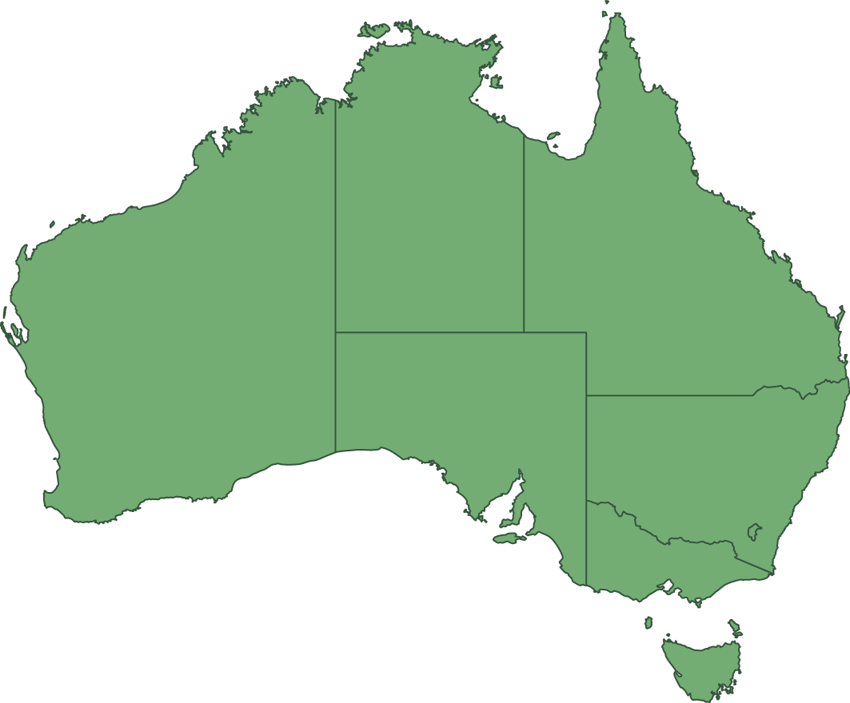
Add title
Notes:
Image – Australia map green

