Slide 1
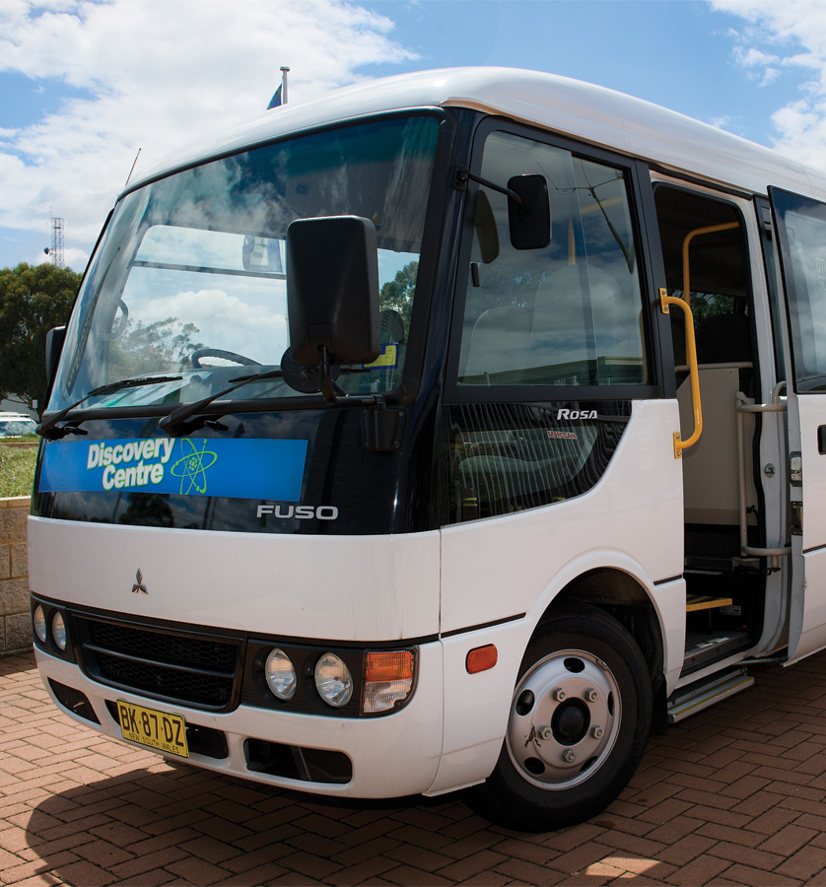
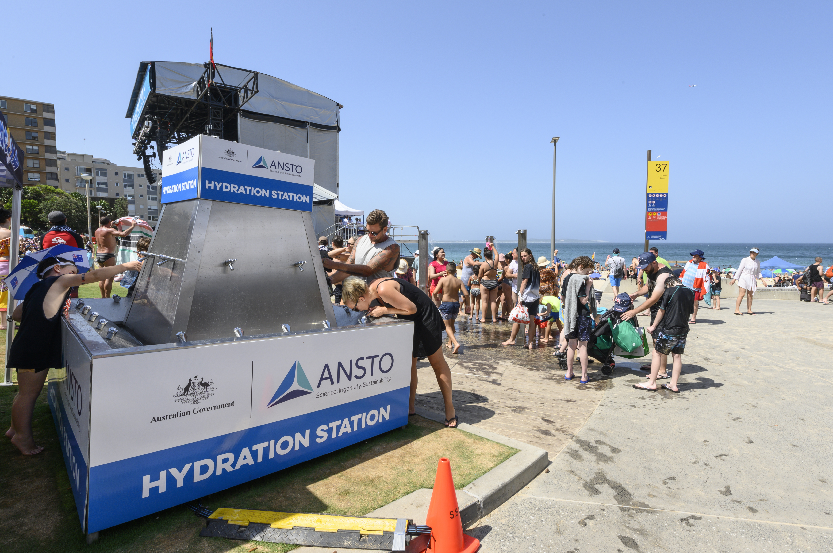
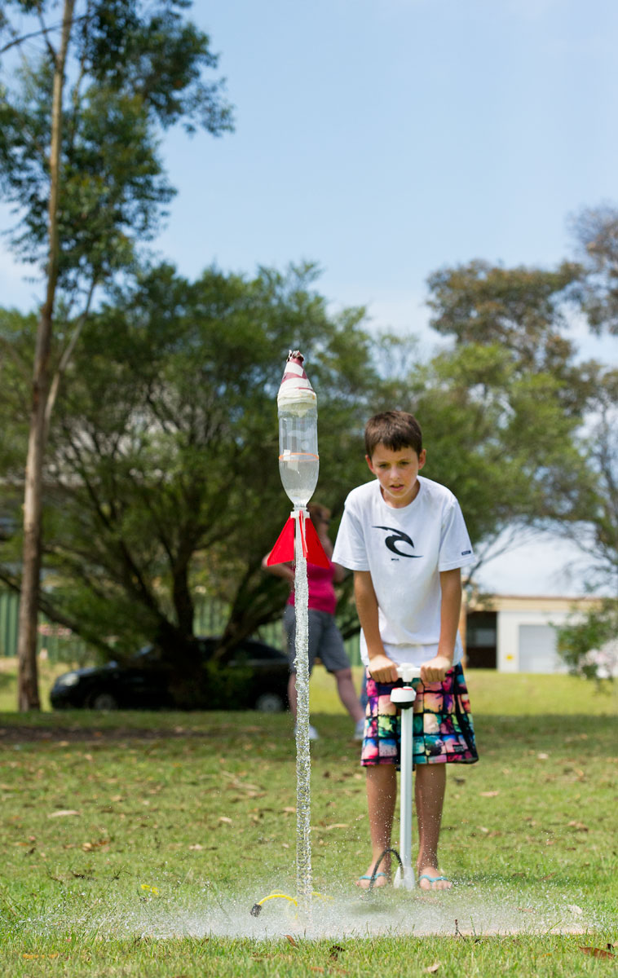
Discovery Centre
Tours
Educational and community events
Science workshops
Notes:
And international
We use a range of ways or “channels” to community with our audiences.
Staff Forum
Website
Intranet
Brochures
Advertising
Conferences
Discovery Centre
Education
ANZSNM conference
Questacon Kids Show
Fact or Fiction
People 1
People 2

