Slide 1
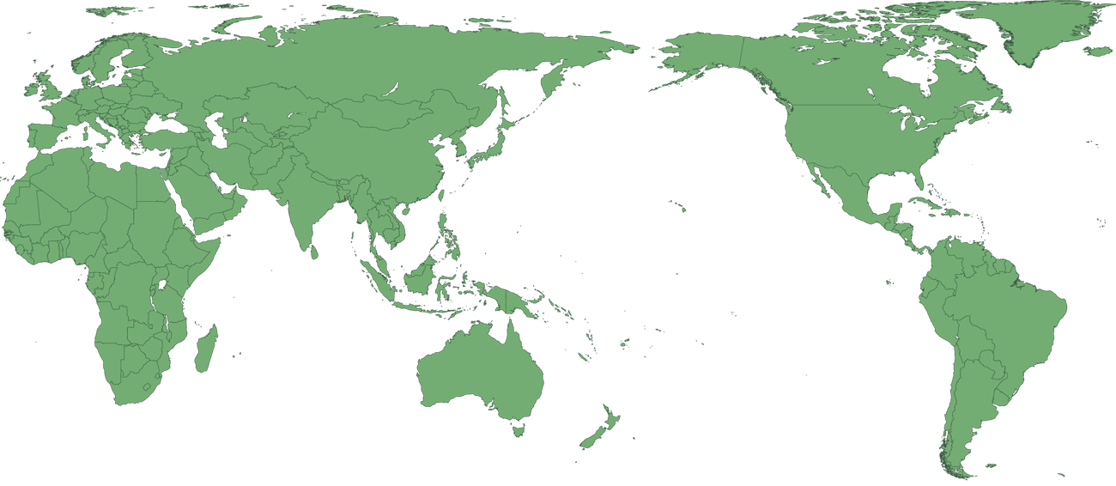
Add title
Notes:
Image – world map blue

