Slide 1
Leveraging great science to deliver big outcomes

Slide 2
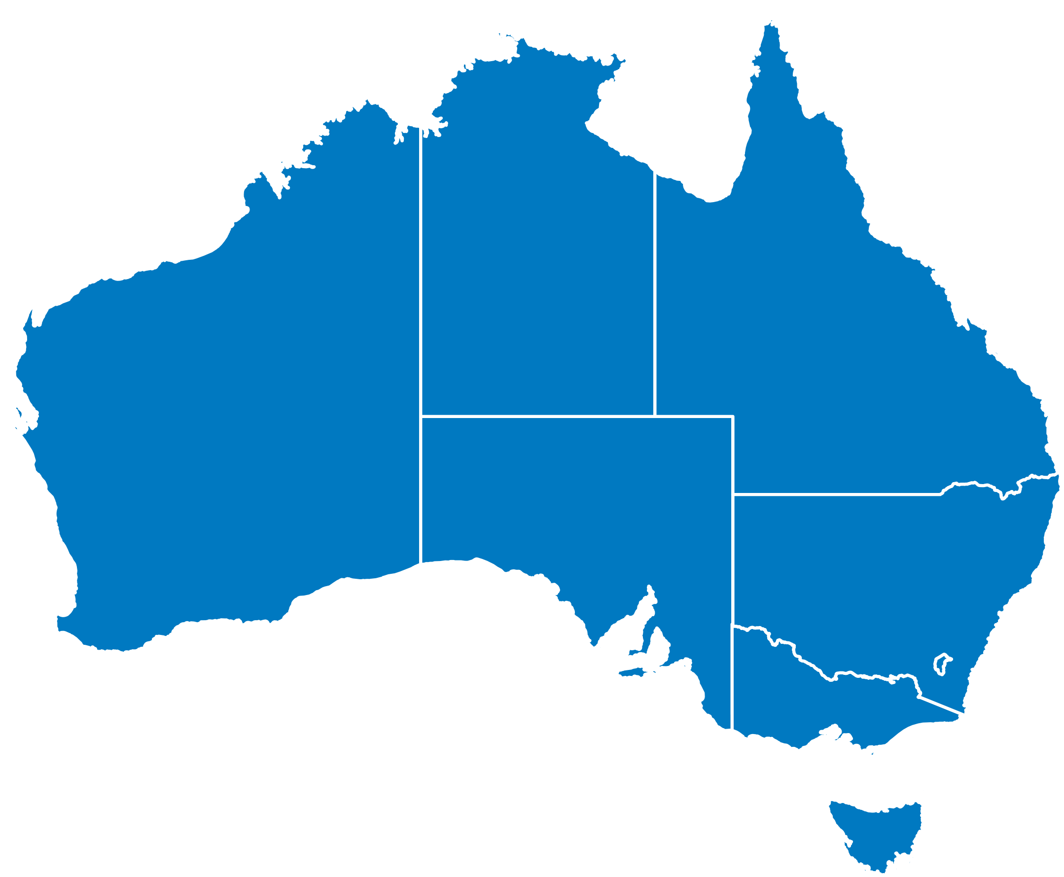
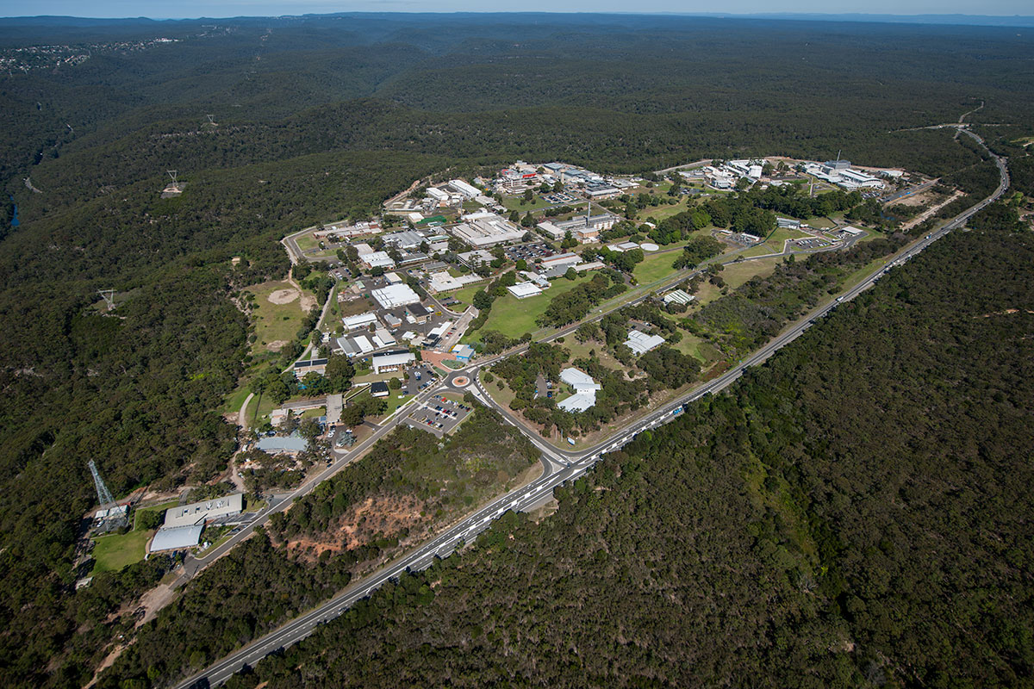
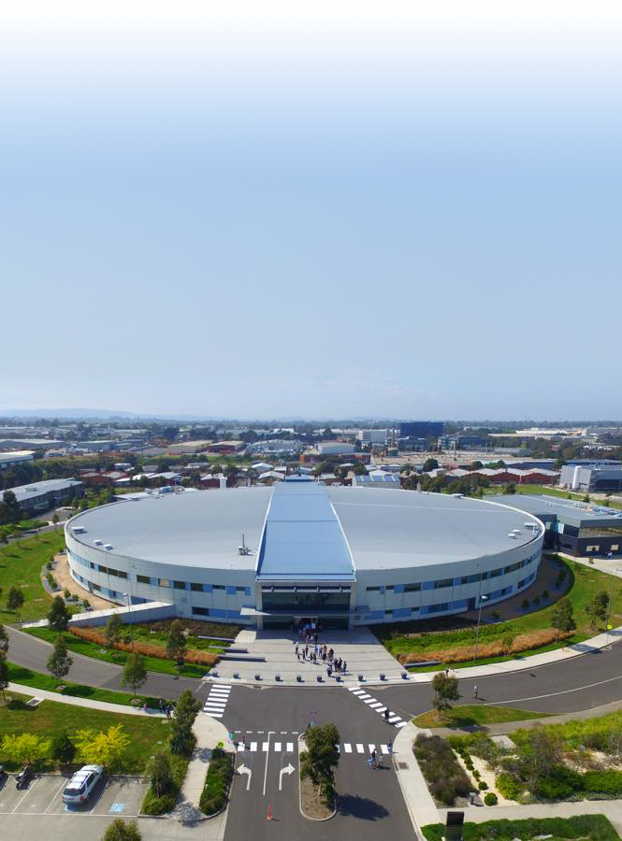
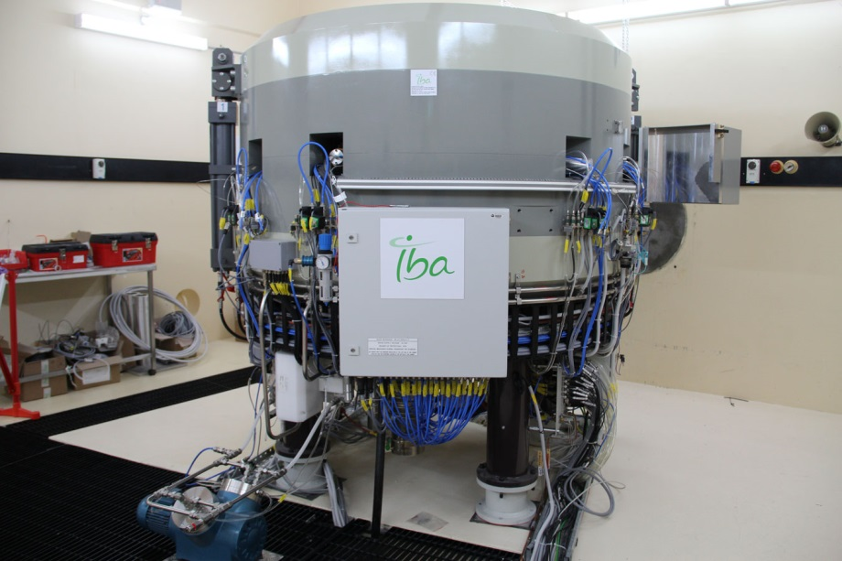
ANSTO | Home of Australia’s landmark research infrastructure
Operating safely for over 60 years
Leaders in nuclear science and technology
Lucas Heights | NSW
Clayton | VIC
Camperdown | NSW
Main campus
Australian Synchrotron
Cyclotron
Notes:
Reviewed Organisational Excellence capability families set and cluster mapped to aggregate into platforms.
Considered:
Drivers
Workflow and infrastructure used
Customer & user base ~ product similarity
Competencies
Regulatory coherence
Contribution to research
Location
Value proposition, differentiation & competitive advantage

Slide 3
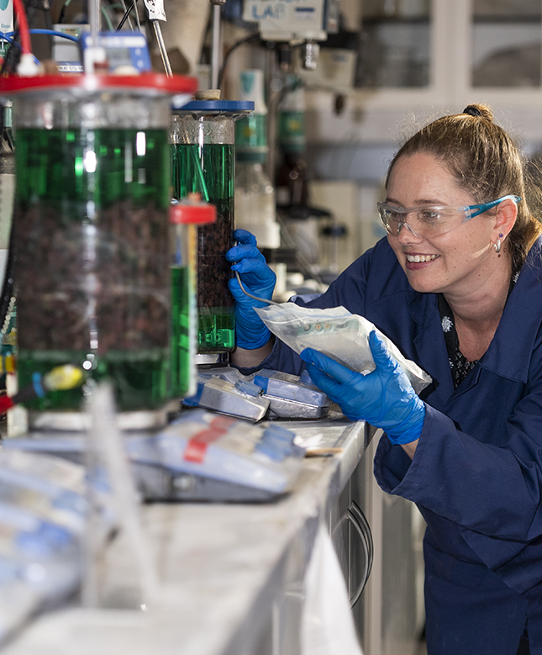
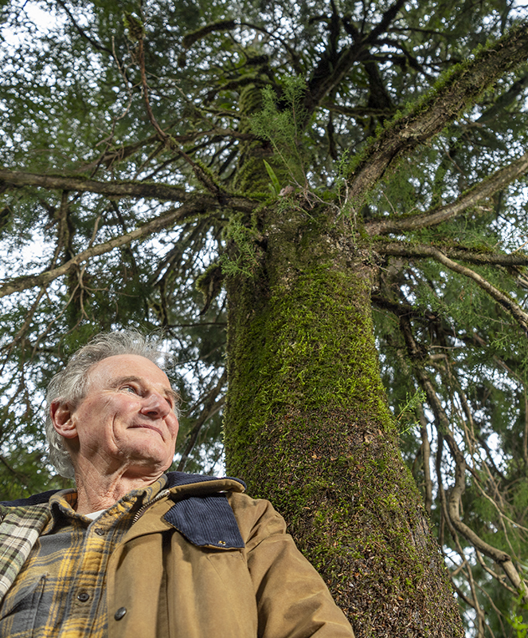
Our work
Human health
Support to industry
Protecting the environment
Notes:
Our work improves human health, saves lives, builds our industries and protects the environment.

Slide 4
ANSTO’s functions
National benefits
Users, customers and stakeholders
Partnerships
Government and reputation
Distinctive competencies
Nuclear stewardship
ANSTO Business
Nuclear Science and Technology
Nuclear Operations

Slide 5
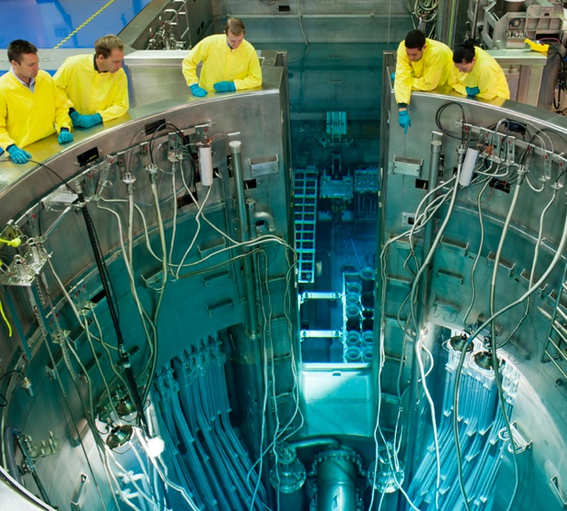
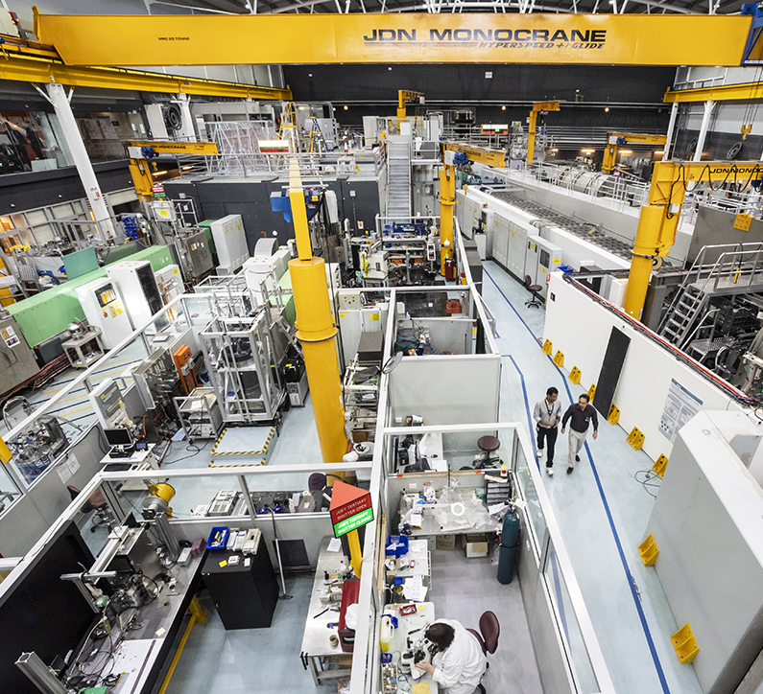
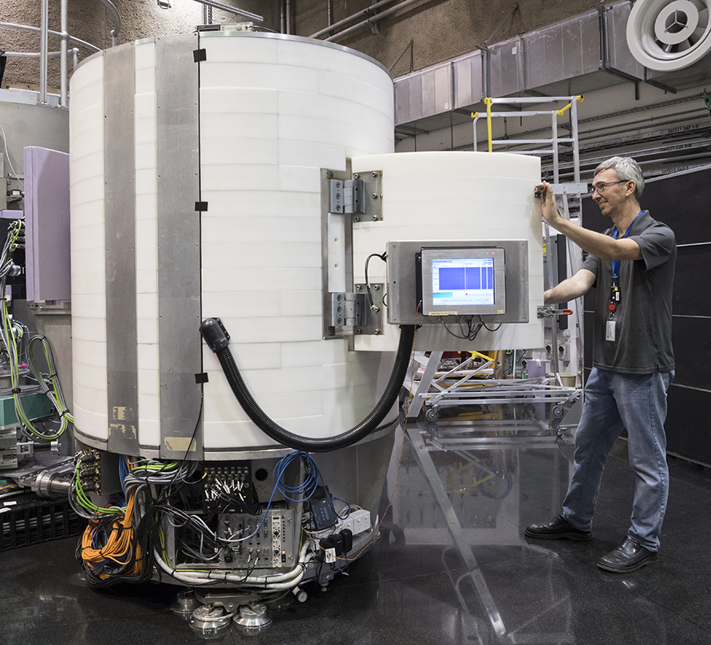
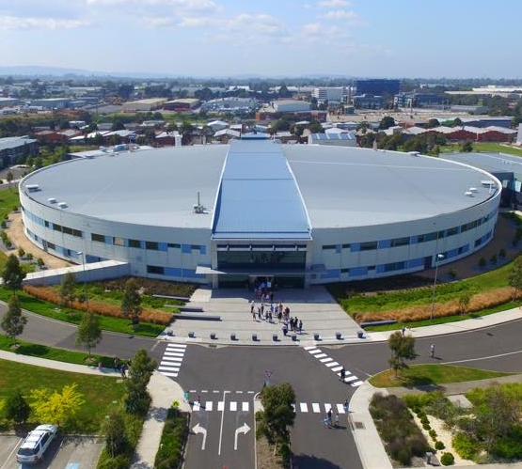
World class research and user facilities
Notes:
ANSTO is the home of Australia’s most significant landmark and national infrastructure for research with thousands of scientists from industry and academia, benefiting from gaining access to state-of-the-art instruments every year.
We do this using our country’s most sophisticated research infrastructure, including the Open Pool Australian Light-water (OPAL) multi-purpose reactor, the Australian Synchrotron, the Centre for Accelerator Science (CAS), the Australian Centre for Neutron Scattering (ACNS) and the National Deuteration Facility (NDF).
Every year, ANSTO researchers plus over 5000 visiting national and international researchers and industry researchers use our facilities.

Slide 6
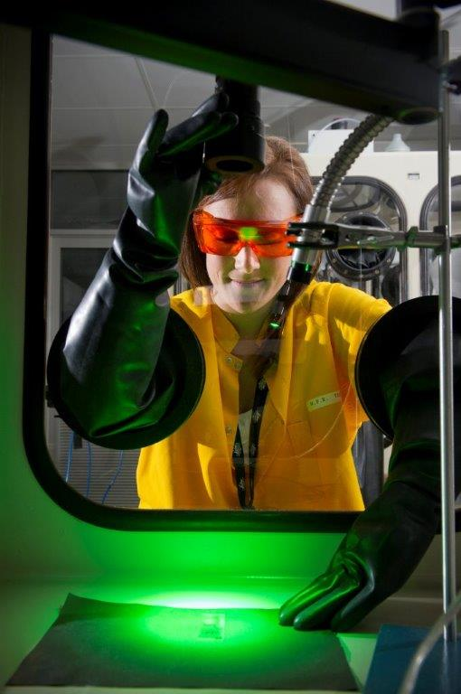
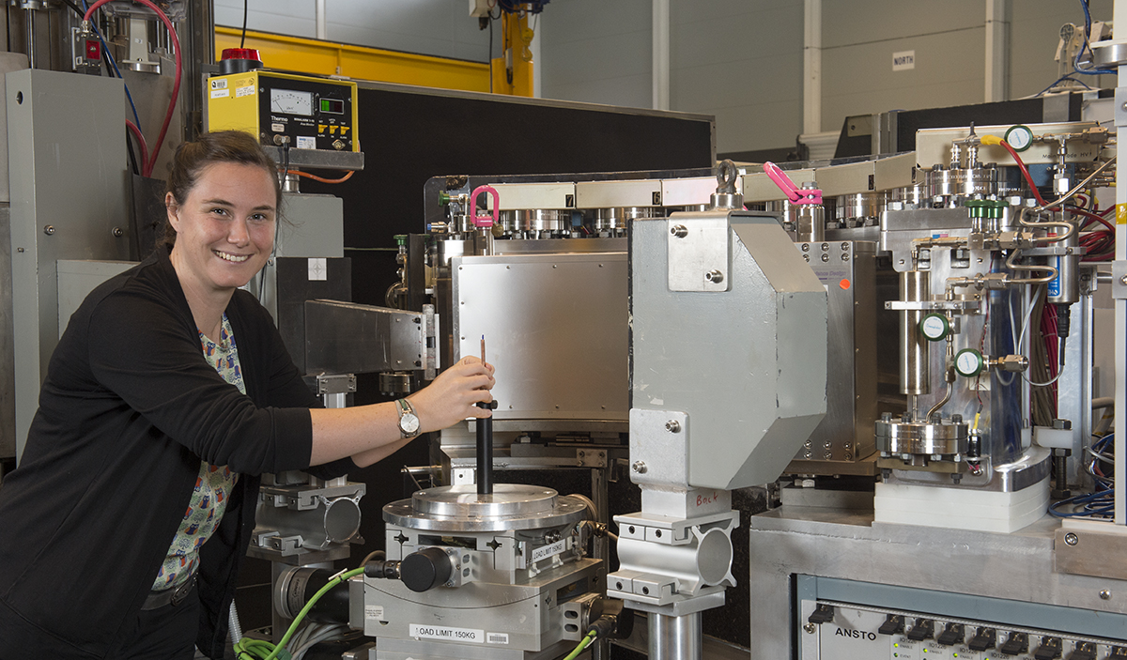
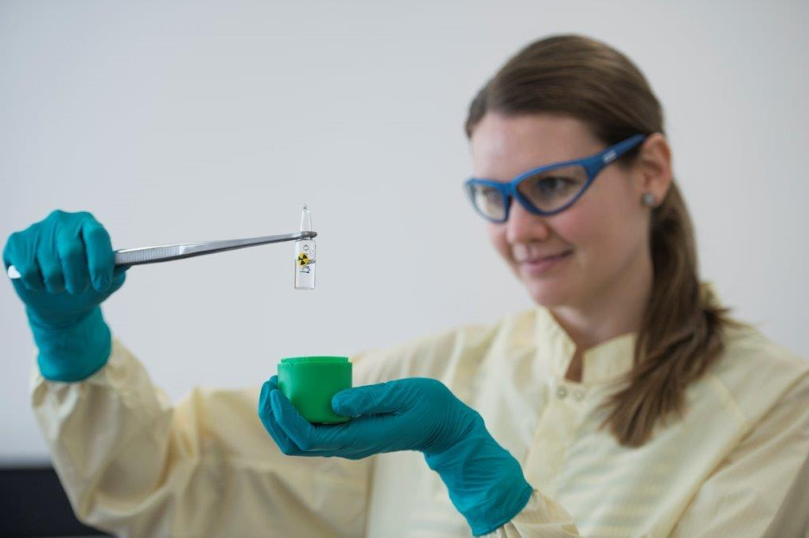
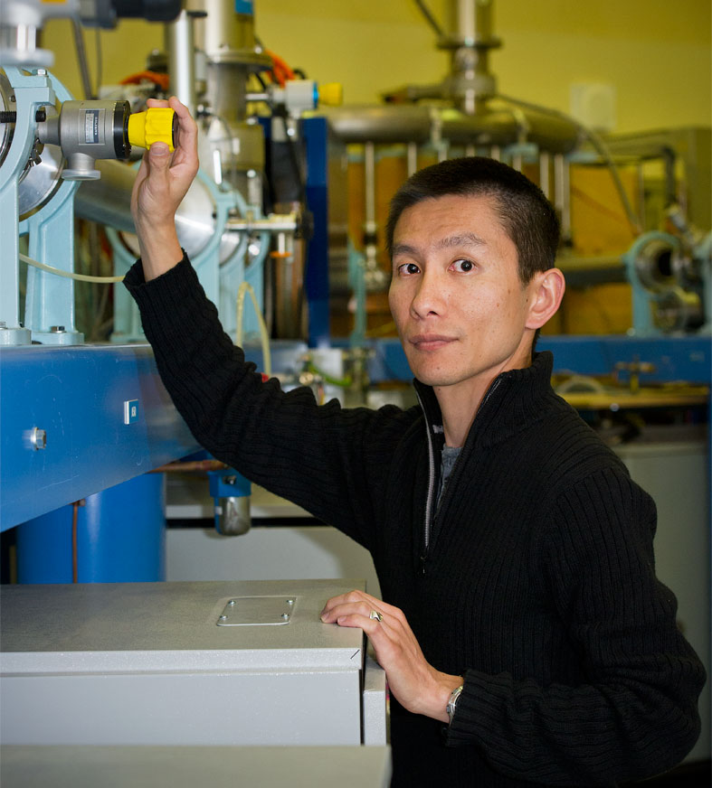
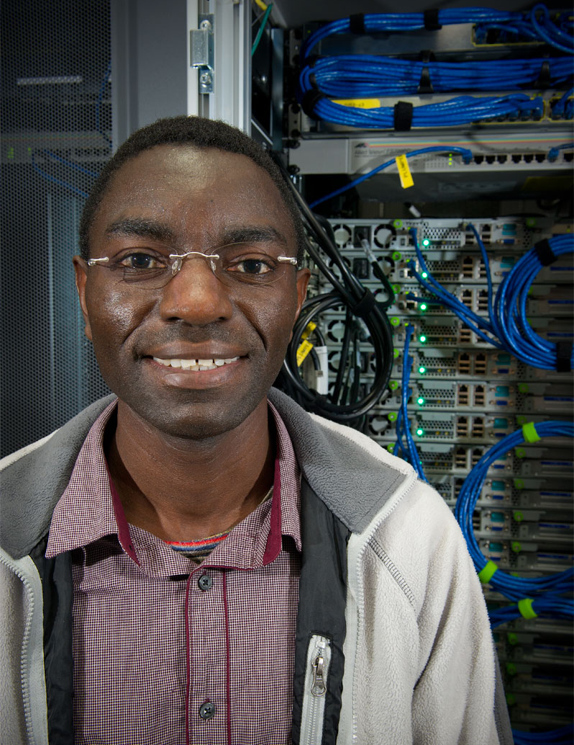
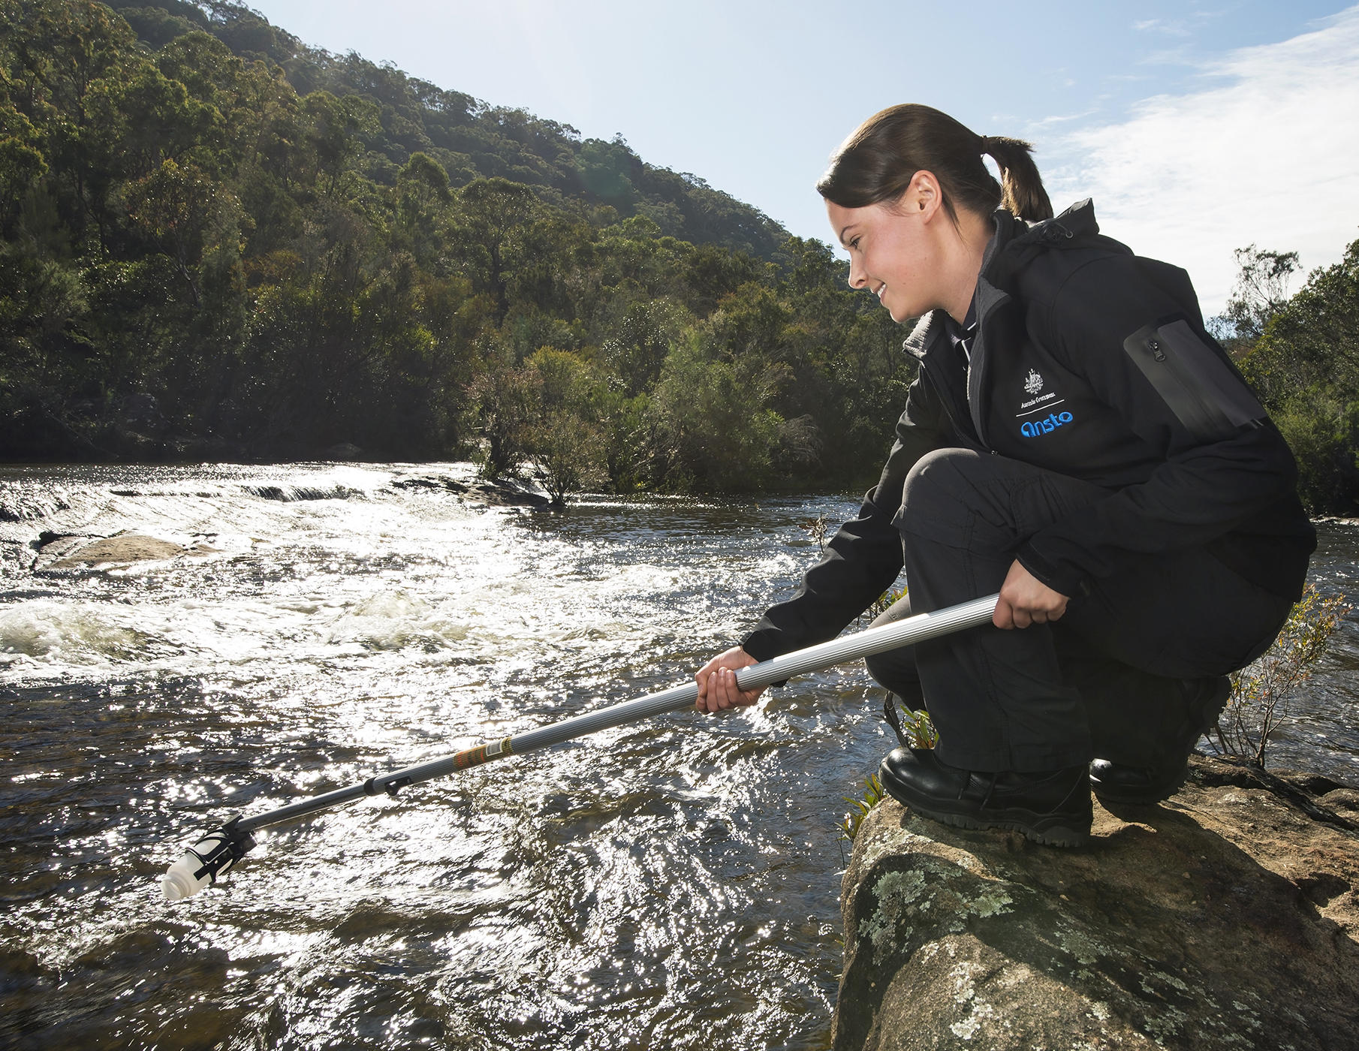
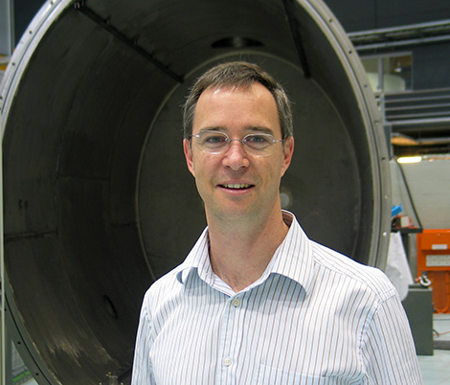
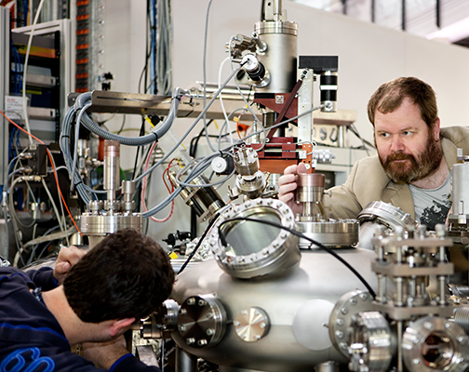
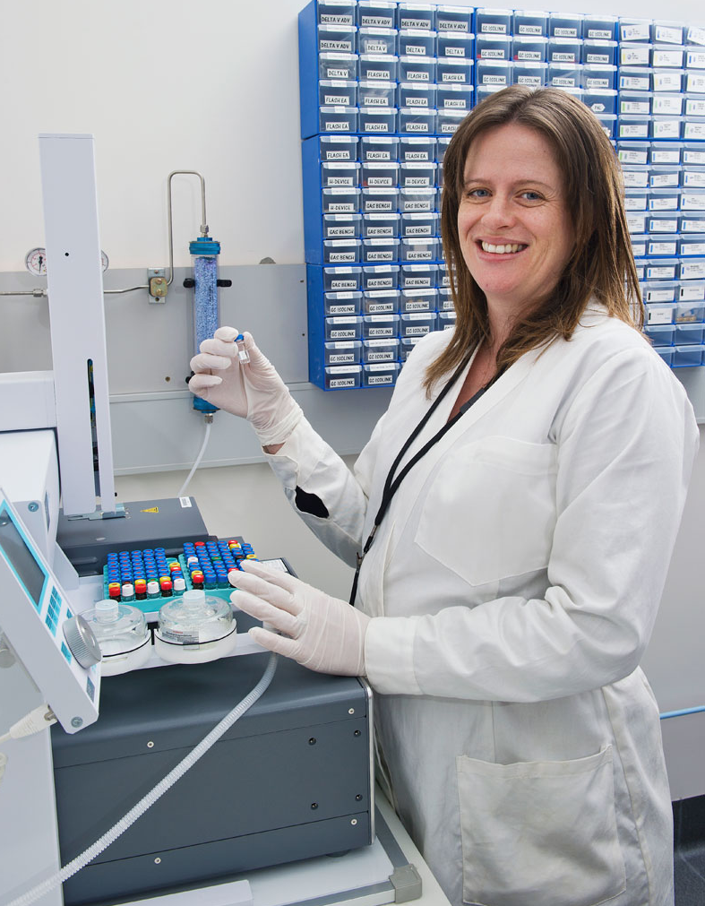
Enabled by people and partnerships

Slide 7
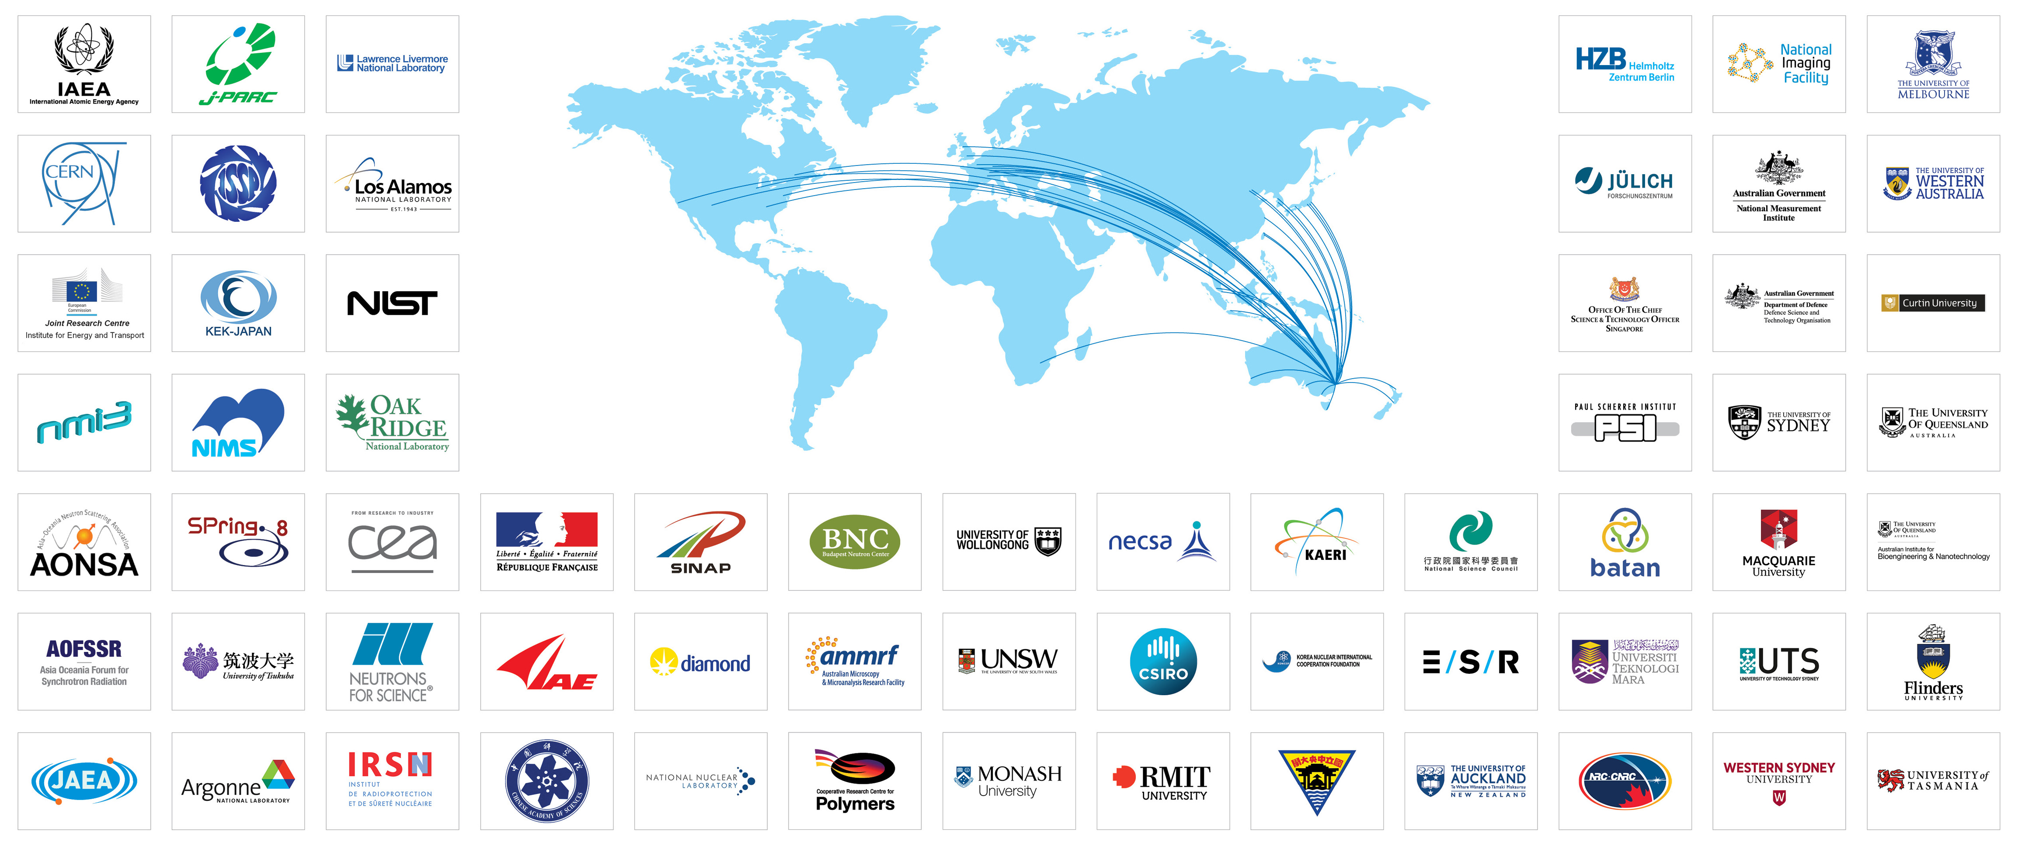
Globally connected

Slide 8
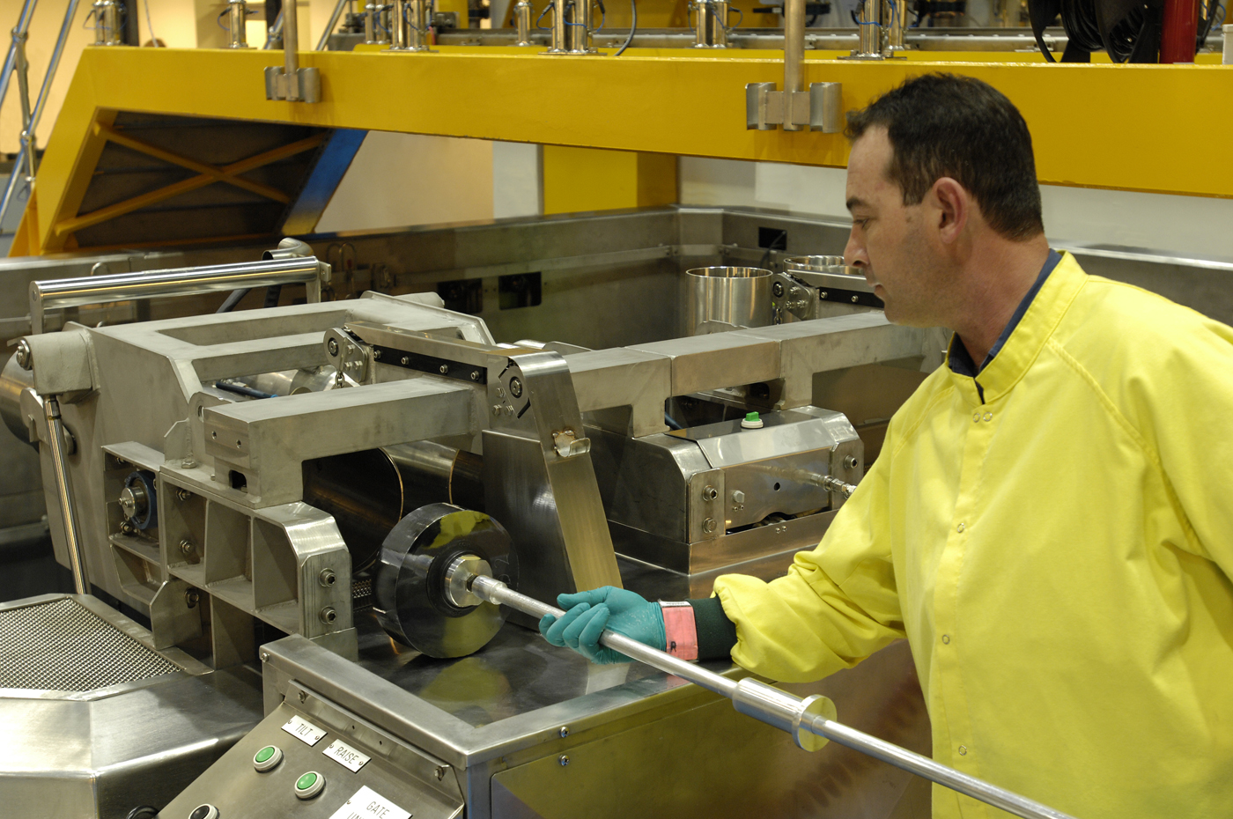
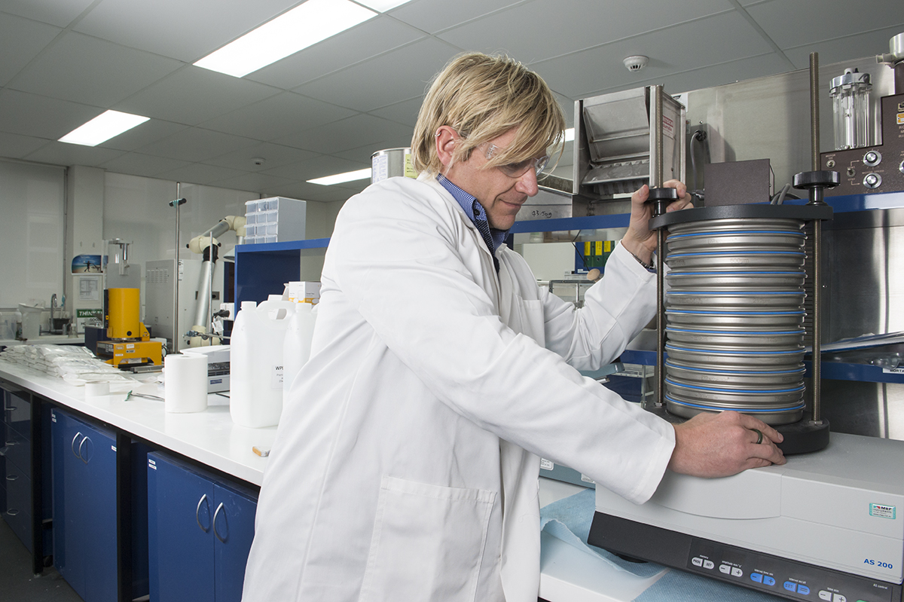
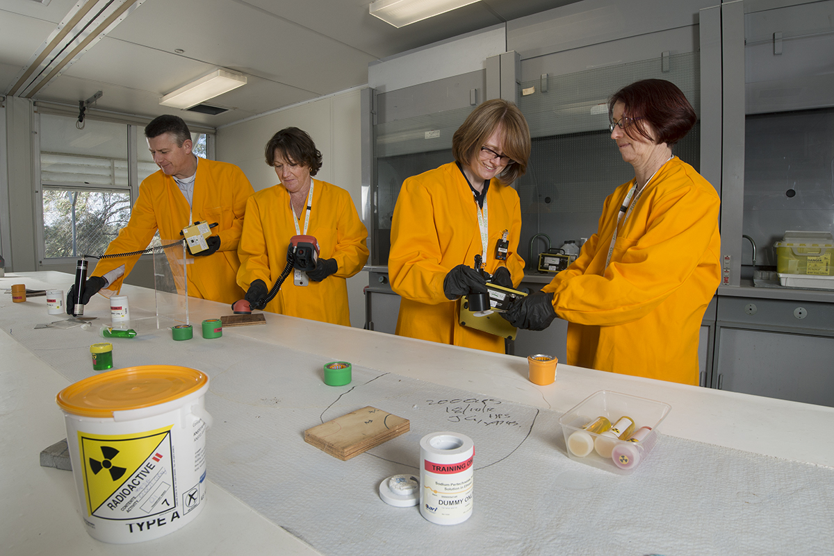
Products and services
Nuclear medicine production
Minerals consulting
Irradiation services
Nuclear waste solutions
Radiation services

Slide 9
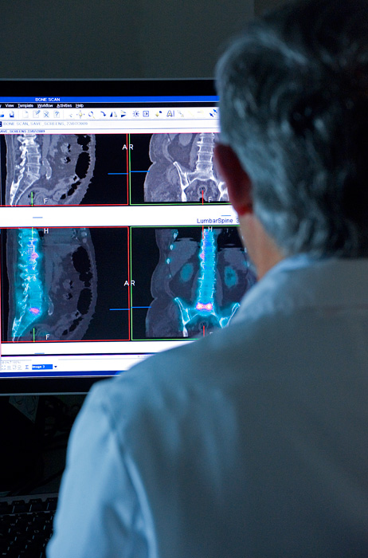
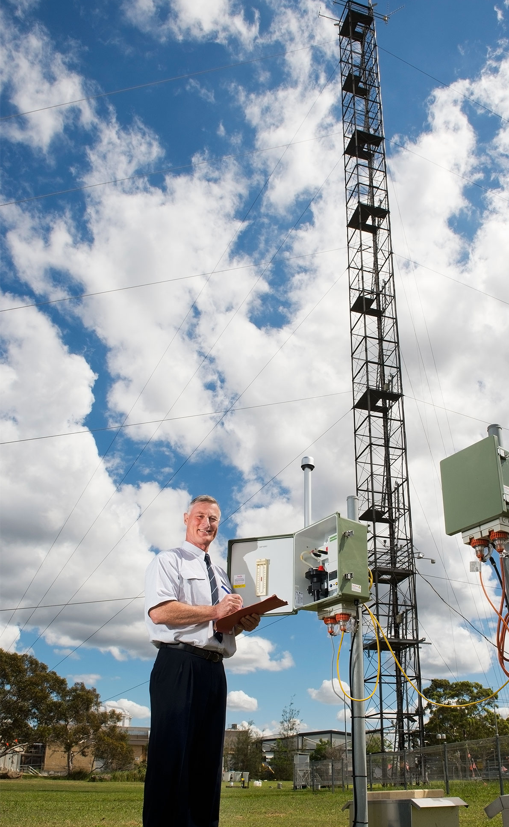
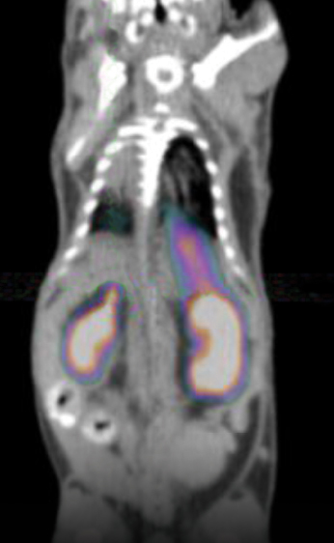
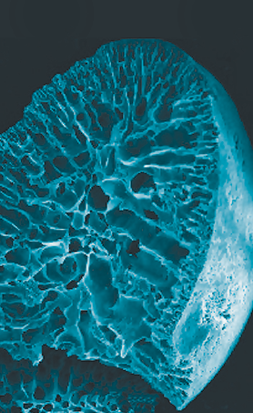
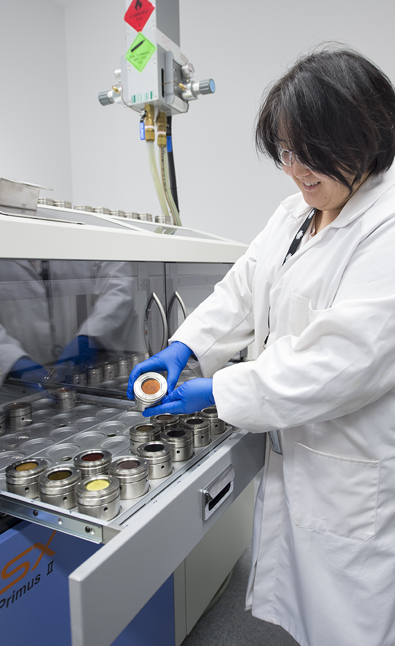
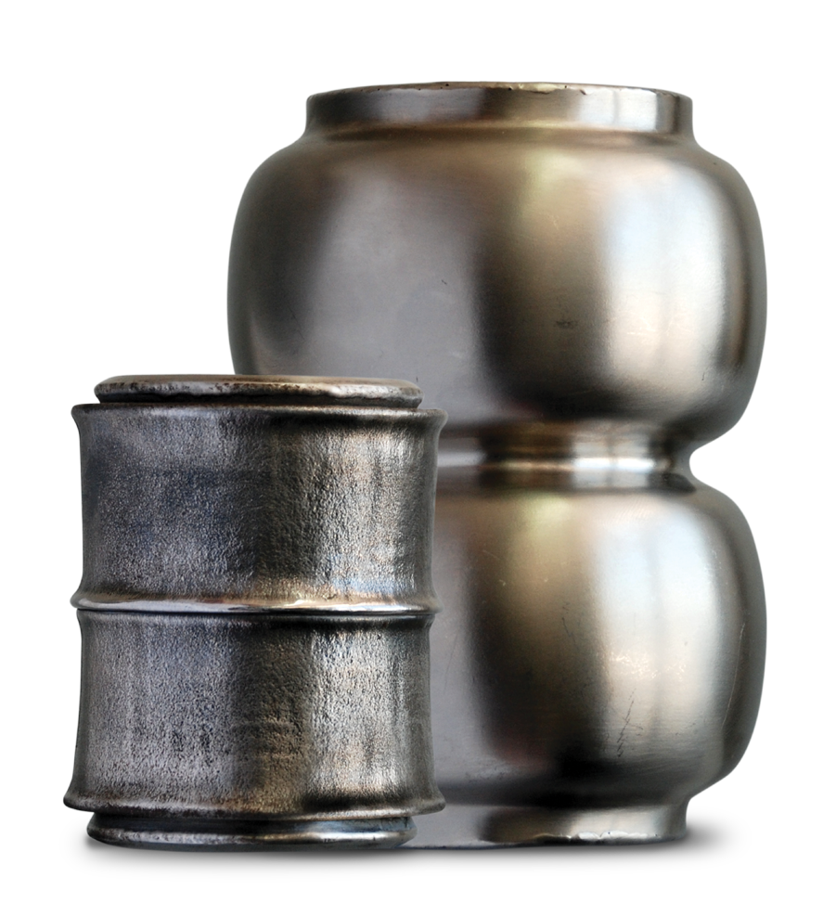
Science diversity and technology expertise
Notes:
Understanding, diagnosing and treating disease
Studies of atmosphere
Ice cores
TSPO knockout mouse
Materials science and engineering
Contaminant impacts
Nuclear waste forms
Minerals consultancy
Drug development at AS
Cultural heritage – archaeology, palaeontology, art etc

