Slide 1
ANSTO Nuclear Medicine Project

Slide 2
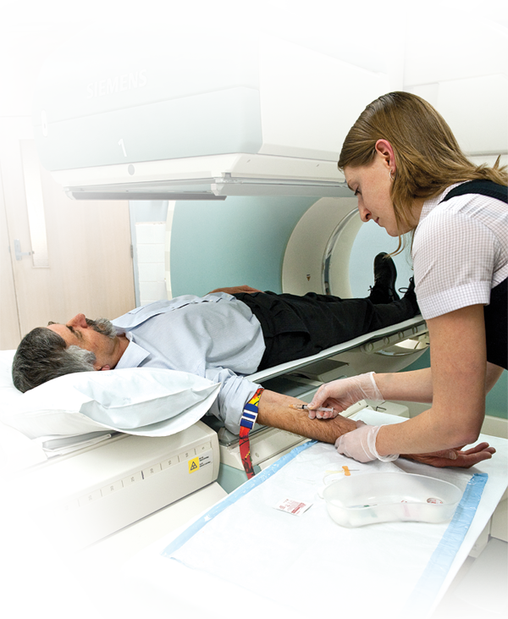

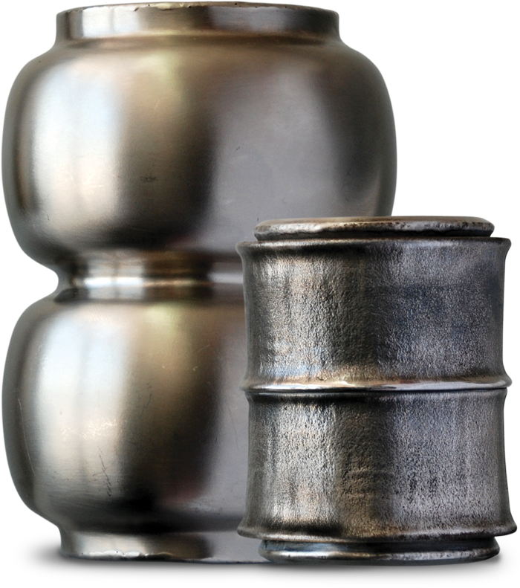
Overview of ANM
1.
2.
3.
Nuclear Medicine
Facility
Synroc waste
treatment plant
Jobs
Notes:
Quick overview of the project – two major component – nuclear medicine facility and Synroc waste treatment plant.
Guarantee the future supply of nuclear medicines for all Australians now and into the future. These medicines will be required by one in two Australians during their lifetime.

Slide 3
The ANSTO Nuclear Medicine Project
A new Mo-99 production facility for ANSTO
Mo-99 production capacity to allow for increased exports
First full scale operational Synroc facility in the world
Notes:
Design, build and operate new Mo-99 production with IP licensed from NTP and build and operate Synroc facilities using ANSTO IP at ANSTO by June 2015
Mo-99 Facility capacity = 3,600 6 day Ci per wk (42 wks)
150 domestic, 350 contingency, balance exportable
estimated revenue circa A$2m per week
SYNROC Facility capacity = 100-150 HIP cans/year
Treatment of both legacy acidic and new alkaline wastes
Final storage volume 100 times LESS than for Cementation

Slide 4
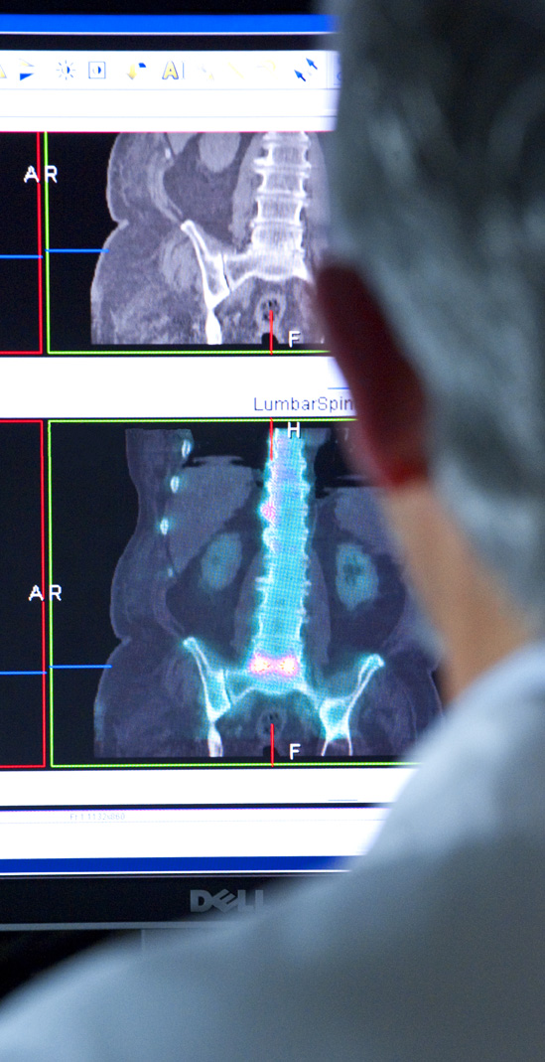
Why Molybdenum-99 (Mo-99)?
80% of all nuclear medicine procedures use Mo-99/Tc-99m
Diagnosing heart disease, cancer, neurological disorders and other conditions
40 million patients per year
Global market of US$550 million per annum
Notes:
Central part of ANSTO’s Business is production of nuclear medicines – one in two Australians – 470,000 medicare

Slide 5
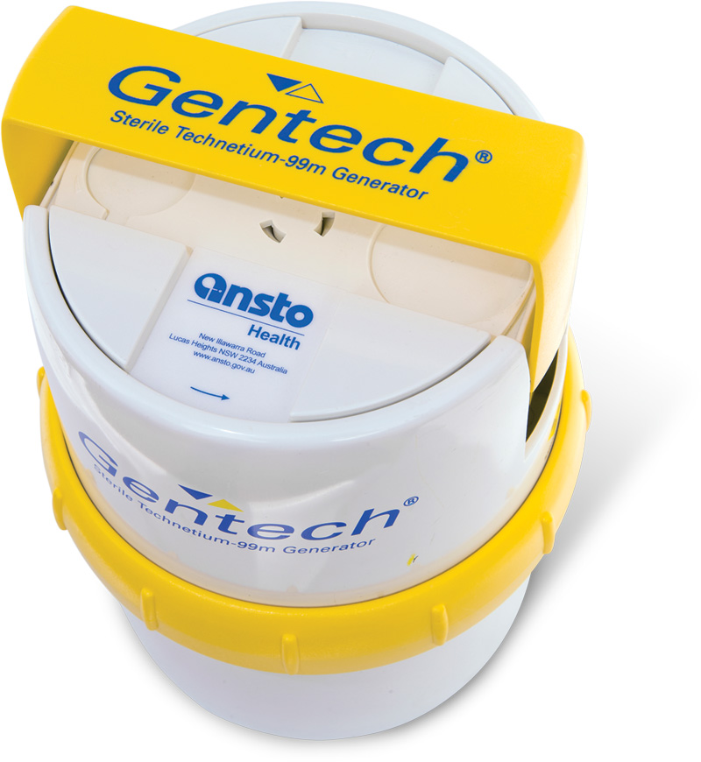
Molybdenum-99
80% of all nuclear medicine procedures use Mo-99/Tc-99m
Key in diagnosing heart disease, cancer, neurological disorders
and other conditions
40-45 million patients per year
Global market of US$550 million p.a.
Notes:
Central part of ANSTO’s Business is production of nuclear medicines – one in two Australians – 470,000 Medicare
Project we’ve been working on to protect both local and international supply of these medicines. Two notes of caution:
This is a proposal only – it isn’t funded yet
We’re currently seeking funding for this through our Minister’s Portfolio Budget submission – consider this conversation Cabinet-in-Confidence.

Slide 6
Ensuring security of supply
Recent critical worldwide Mo-99 shortage
Plant producing 40% of world supply will cease produce by 2016
New ANSTO plant will ensure constant and reliable supply of radioisotopes to benefit Australia
Opportunity to play a crucial role in the international arena alongside non-proliferation
Notes:
Recent critical worldwide Mo-99 shortage and ageing reactors
NRU in America produces 40% of world supply and will cease to produce Mo-99 by 2016
New plant will ensure constant and reliable supply of radioisotopes to benefit Australia
Opportunity to play a crucial role in the international arena alongside non-proliferation

Slide 7
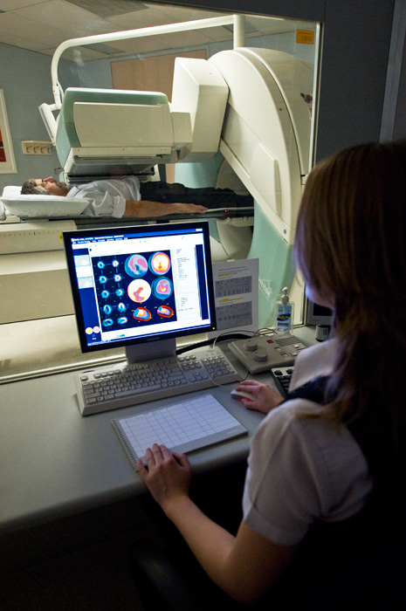
Nuclear medicine
10,000 hospitals in the world use radioisotopes
Radioisotopes are produced by neutron bombardment and/or activation of targets in test & research reactors
(e.g., Mo-99, I-131)
or
by activation of targets in cyclotrons (e.g., F-18, I-123)
10%
90%
  Diagnostics (cardiology, oncology, neurology)
  Therapy / palliative care
Notes:
Technetium-99m is generated from molybdenum-99, which has a half-life of 66 hours, allowing it to be transported over fairly long distances.
The Tc-99m Generator
Nuclear medicine is a branch of medicine that uses radioisotopes for research diagnosis and treatment of disease. For instance, technetium-99m is used in 20 million diagnostic nuclear medical procedures, half of which are bone scans, and the other half are roughly divided between kidney, heart and lung scans. Approximately 85 percent of diagnostic imaging procedures in nuclear medicine use this isotope.
Technetium-99 has a radioactive half-life of 212,000 years. Technetium-99m (called metastable Tc-99) decays to Tc-99 primarily by gamma emission, and has a half-life of only about 6 hours. Technetium-99 decays to form ruthenium-99, which is stable, by emitting beta and gamma radiation.
In this case, the nuclear reactor provides the molybdenum for the technetium generator. Molybdenum-99 has a short (66 hour) half-life, and decays to the even shorter-lived Tc-99m.

Slide 8

Supply chain
OPAL Reactor | Processing Plant (ANM) | Global distribution | Local distribution of finished goods | Hospital and Pharmacy | Clinical Imaging | Health Outcomes
LEU U²³⁵ targets irradiated in OPAL | Mo-99 separated and purified | Bulk Mo-99 Shipped to meet global demand | Tc-99m Generators dispensed and transported | Tc-99m eluted and combined with cold kits | Product administered to patients for imaging | Imaging helps diagnosis & leads to appropriate treatments
3-12 days | 1 day | 1 day | 1 day | 5 minutes | - | -
Challenging supply chain

Slide 9
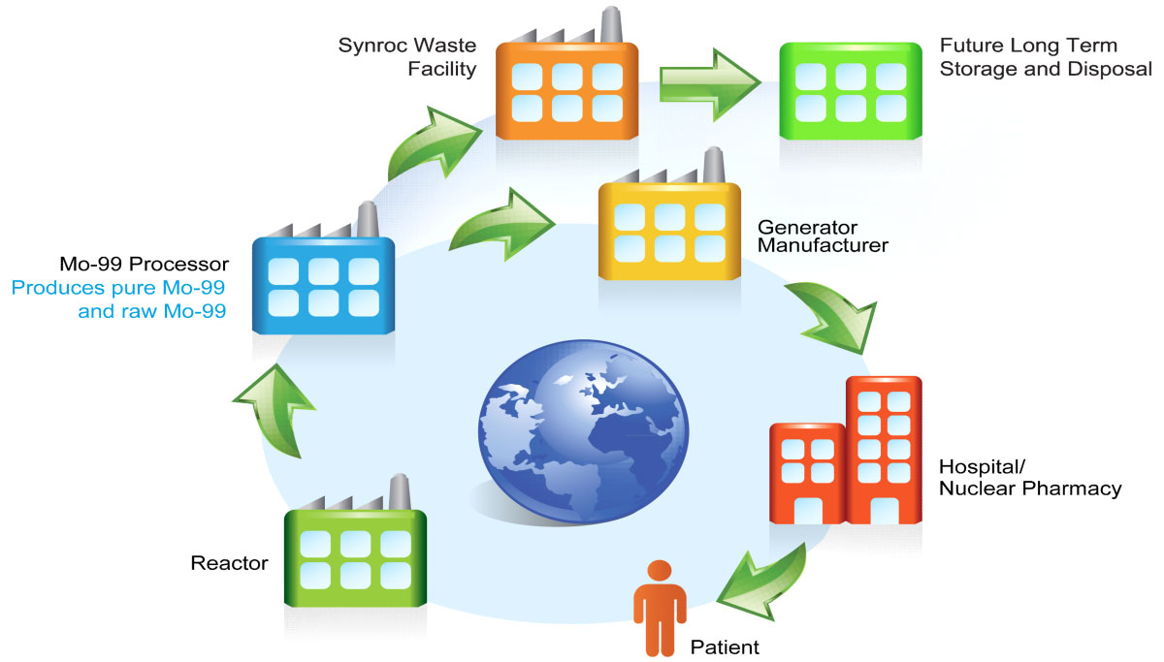
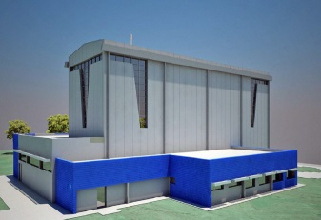
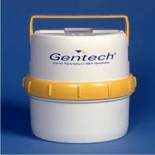
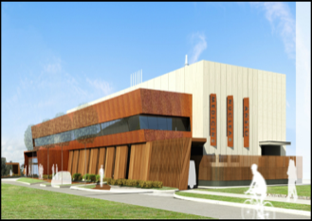

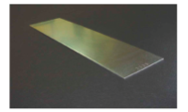
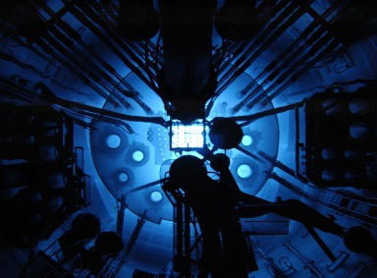
Mo-99/Tc99m Supply Chain
Key in diagnosing heart disease, cancer, neurological disorders and other conditions
80% of nuclear medicine procedures
40-45 million patients per year worldwide

Slide 10
ANM Program Objectives
Complete ANM Program of work within the approved budget and milestones.
Continue to supply Australia’s Mo-99 beyond the shutdown of current facility.
Capitalise on the commercial opportunity to significantly increase export of Mo-99 per week to the global community.
Provide a Synroc solution for the treatment of Intermediate Level Liquid Waste (ILLW) from new ANM Mo-99 production plant and legacy waste.
Develop capability to engineer customised nuclear waste treatment solutions based on Synroc technology.

Slide 11
Ensuring security of supply
Recent critical worldwide Mo-99 shortage
Plant producing 40% of world supply will cease produce by 2016
New ANSTO plant will ensure constant and reliable supply of radioisotopes to benefit Australia and allow for increased exports
Opportunity to play a crucial role in the international arena alongside non-proliferation
Notes:
Recent critical worldwide Mo-99 shortage and ageing reactors
NRU in America produces 40% of world supply and will cease to produce Mo-99 by 2016
New plant will ensure constant and reliable supply of radioisotopes to benefit Australia
Opportunity to play a crucial role in the international arena alongside non-proliferation

Slide 12
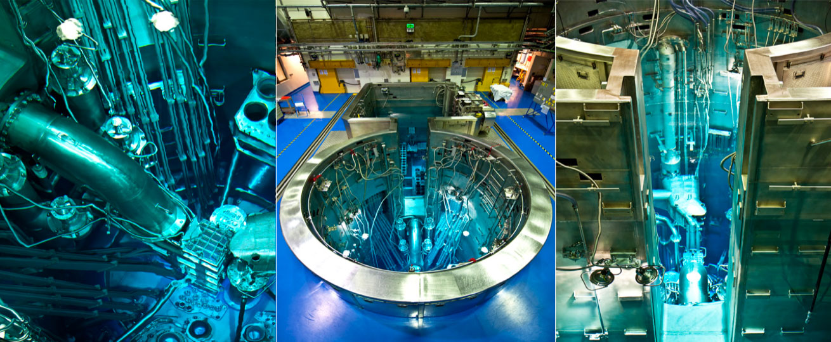
Leading the world in LEU medicine
Notes:
12
Most of the world’s major research reactors use high enriched uranium to produce Mo-99.
OPAL operates with low enriched uranium (LEU) and ANSTO has the benefit of many years of experience in Mo-99 production using LEU
In support of the non-proliferation treaty, all Mo-99 producing nations have agreed to encourage the conversion to low enriched uranium targets, where technically and economically feasible.
ANSTO has the opportunity to be the world’s first large-scale producer of Mo-99 sourced from low-enriched uranium, this represents and important confluence between peaceful uses of nuclear technology and international nuclear security goals.
A number of countries worldwide have expressed a preference for radiopharmaceuticals produced in a reactor which uses low enriched uranium, Australia’s global leadership in this area will encourage the development of low enriched nuclear technology worldwide.
95% global Mo-99 utilises HEU targets. These contain weapons-grade uranium-235
This is Australia’s opportunity to show the world that you don’t need highly enriched uranium to make nuclear medicines. Less demand for HEU on the international market, less of it being made, less available for weapons purposes. Other countries will seek to gain our competetive advantage and make LEU medicine.

Slide 13
Supplying Australia and the world
Notes:
New manufacturing plant - ANSTO currently manufactures 550,000 doses of Mo-99 every year but ANSTO’s manufacturing plant will close by July 2017.
Sweating the assets
Increase demand globally due to an ageing population, greater demand for better patient care and growing demand from the emerging economies, especially Asia. Even on the most conservative estimates, global demand for Mo-99 will increase 20% by 2016.
Collocated with this manufacturing plant will be a Synroc waste treatment facility. Synroc technology will be used to treat the 12,000 litres of litres of Australia’s legacy waste from past production of Mo-99 is temporarily stored on site at ANSTO and the additional 4,000 litres generated from new Mo-99 manufacturing.
This waste is an accepted responsibility of the Australian Government.

Slide 14

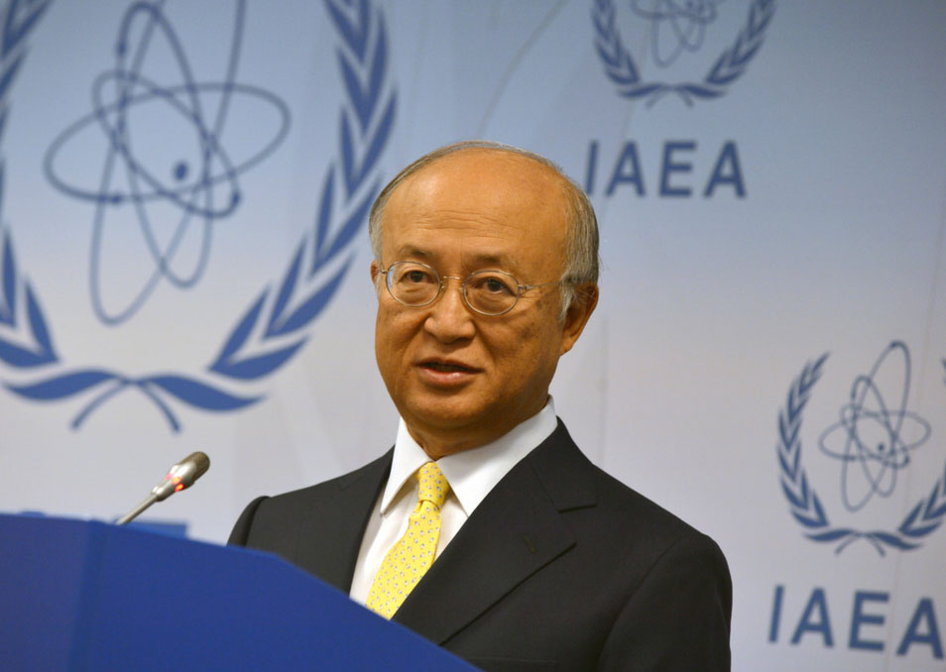
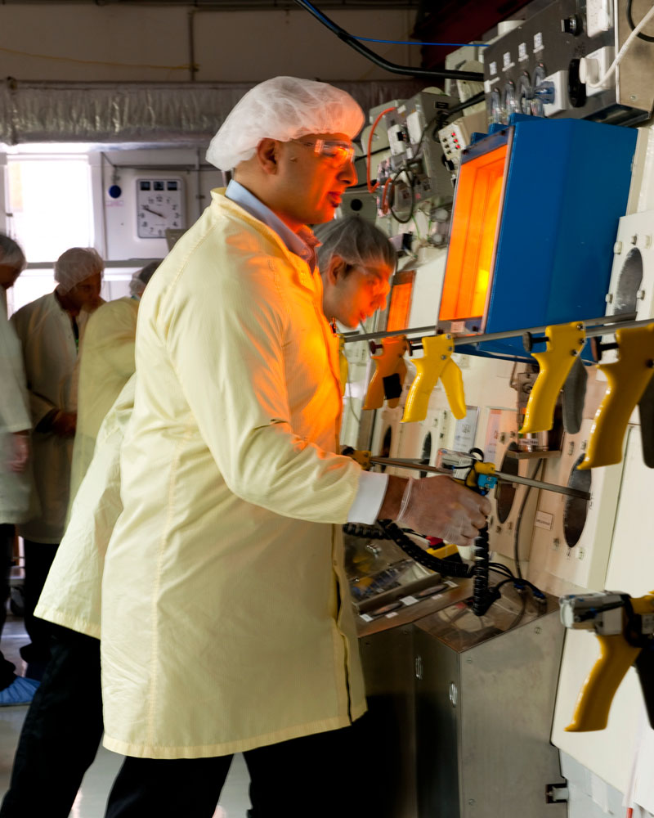
Key elements
Secure medicine supply for Australia
and the world
Driving global
non-proliferation
Showcasing Australian innovation
Notes:
Secure medicine supply for Australia and the world
Australia’s existing Mo-99 facilities must close by 2017.
With this plant we believe we can meet demand in the US and become the primary Mo-99 supplier for Southeast Asia.
95% of the world’s major research reactors use high enriched uranium to produce Mo-99.
Australia’s OPAL research reactor operates with low enriched uranium targets and ANSTO has the benefit of many years of experience in Mo-99 production using low enriched uranium.
ANSTO has the opportunity to be the world’s first large-scale producer of Mo-99 sourced from low-enriched uranium.
This represents and important confluence of peaceful uses of nuclear technology and international nuclear security goals.
Driving global non-proliferation (pictured is Mr Yukiya Amano, Director General of the IAEA)
Mo-99 is used in 45 million procedures worldwide every year, and currently most of that global Mo-99 supply is produced in reactors fuelled by Highly Enriched Uranium.
The fact is Highly Enriched Uranium can be used in nuclear weapons. That’s why alternative manufacturing processes for this important medicine are highly desirable – as recognised by the fact the US has put measures in place to favour Mo-99 produced in reactors fuelled by proliferation-proof low enriched uranium, such as that made in Australia’s OPAL’s reactor.
The development of this facility – and a global supply of Mo-99 in Australia - significantly strengthens Australia’s position as an important contributor to global nuclear security and non-proliferation.
By providing a viable alternative to medicine produced from Highly Enriched Uranium reactors, we are providing one less reason to have them.
Showcasing Australian innovation
Creating 100 ongoing high-tech manufacturing jobs.
Synroc plant will safely and economically treat waste and showcase Australian innovation to encourage other countries to adopt our technology.

Slide 15
The Nuclear Medicine Facility
Nuclear Medicine Facility

Slide 16
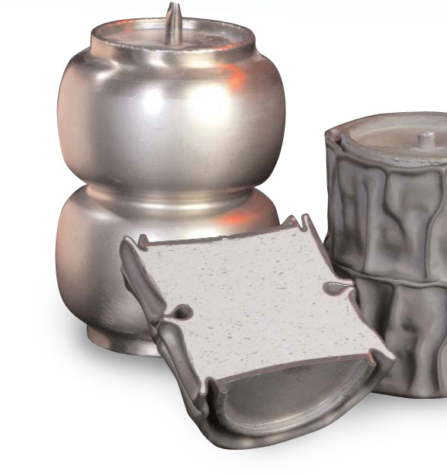
Synroc: the waste solution
Intermediate Level Liquid Waste, ILLW, will be managed using this technology
Synroc conceived in Australia and technology developed at ANSTO
Potential to treat radioactive wastes world wide including high level waste
Synroc is the safest and most economic method for dealing with waste
Notes:
Synroc is the best way to make waste safe for future generations.
Over 12,000 litres of liquid nuclear waste has been generated since Australia began small-scale manufacturing of nuclear medicines some 43 years ago. There is also small amounts of nuclear waste stored at 100 locations across Australia.
In addition, the proposed new Mo-99 manufacturing facility will generate an additional 4000 litres of waste
This waste is an accepted responsibility of the Government.
At the moment this waste is stored on site at ANSTO in liquid tanks. Although those tanks are currently safe, nuclear waste cannot be stored in liquid form indefinitely and must be converted into a form suitable for permanent storage.
Mo-99 producers all over the world have the same problem in treating their waste.
Build a demonstration plant – countries already showing interest but they need to see the demonstration plant
Synroc technology could be exported by Australia to those countries, this is a future industry for Australia. Already have interest from the Department of Environment in the US, Sellafield in the UK and SCK-SEN in Belgium.

Slide 17
Volume of waste at disposal
Cementation final disposal volume
100m³
Alkaline liquid
waste per year
4000L
Final disposal volume
10m³
Synroc®
1m³
Notes:
Without a collocated Synroc plant, Australia’s existing waste would need to be processed using older methods such as cementation.
Cementation is not viable because the final storage volume for cementation-treated waste is 100 times larger than Synroc-treated waste.
This means significantly higher transport and storage costs.
The only other alternative is to build more liquid storage tanks on site, early estimates are that this could cost $3.5 million for each additional storage tank.
There are 55 storage tanks on site at ANSTO which will eventually need replacing if the Synroc facility is not built.

Slide 18
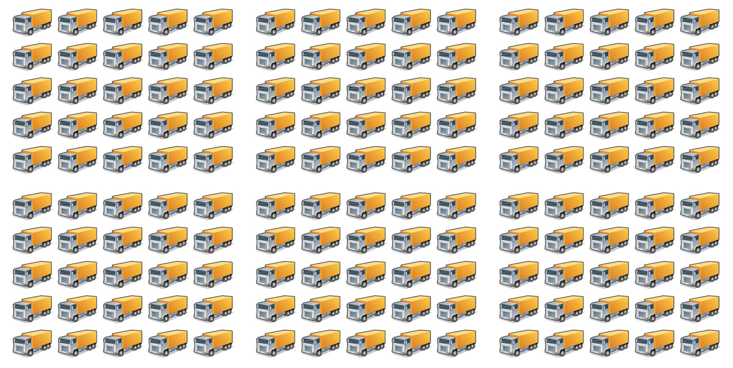
Disposal volume of waste
Cementation transport per 10 years
1560 Tonnes (> 150 trucks)
ANSTO Synroc® transport per 10 years
14 Tonnes
Notes:
Without a collocated Synroc plant, Australia’s existing waste would need to be processed using older methods such as cementation.
Cementation is not viable because the final storage volume for cementation-treated waste is 100 times larger than Synroc-treated waste.
This means significantly higher transport and storage costs.
The only other alternative is to build more liquid storage tanks on site, early estimates are that this could cost $3.5 million for each additional storage tank.
There are 55 storage tanks on site at ANSTO which will eventually need replacing if the Synroc facility is not built.

Slide 19
The Synroc plant
Synroc Plant

Slide 20
Questions?

