Slide 1
Food
Food-environment-health nexus

Slide 2
The nexus
Notes:
With food safety concerns rising in recent years, there is more emphasis than ever on the importance of provenance and transparency in the food industry.
Food safety and biosecurity
Food traceability and provenance
Market intelligence and access
Sustainability driven products and processes
Products for sustainable health and well-being

Slide 3
Seafood provenance
CASE STUDY

Slide 4
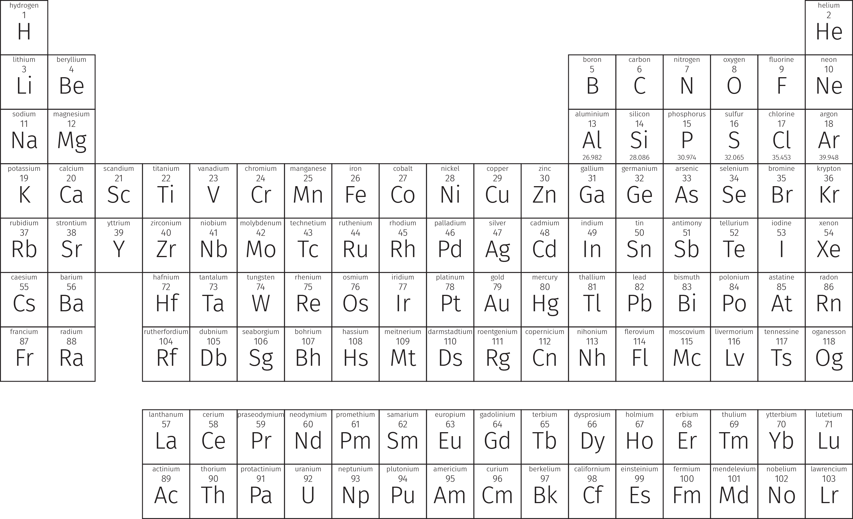
Identifying with an elemental fingerprint

Slide 5
Industry gains
Scientifically validated and detailed provenance model.
Reference capability including dynamic data sets.
Comprehensive quality assessment of mineral composition, nutritional quality.
Quick, cost-effective analytical tool.
Capability will lead to develop farm-specific fingerprints.
Potential to apply other food products.
Notes:
A scientifically validated and detailed provenance model to help distinguish between Australian and imported including farmed and wild-catch
The model will act as a reference capability that will include dynamic data sets which will help to scientifically-validate the source of origin, enhance consumer confidence
Development of a quick, cost-effective analytical tool that will best serve the needs of the seafood producers, import and export industries, including industry bodies and the methodology may act as a deterrent to fraudulent practices and avoid the need for court cases
A comprehensive quality assessment in relation to mineral composition, nutritional quality including omega 3, omega 6 profile, protein profile
The knowledge and expertise gained from building this capability will lead to develop farm-specific fingerprints to protect brands in the future
Potential to apply other food products for provenance determination

