Slide 1
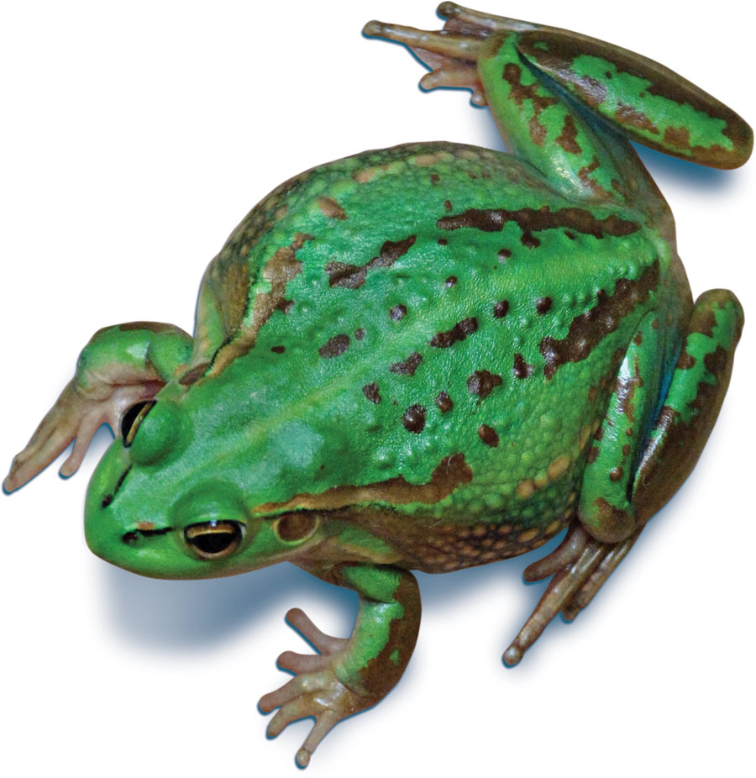
Frog skin could help fight super bugs
Problem
Fight bacterial infections such as methicillin resistant staphylococcus aureus (a strain of staph bacteria) that does not respond to some antibiotics
Approach
Neutron reflectometer used to study synthetic versions of frog skin secretions. In nature, the secretions help the frogs fight bacterial infections
Results
It is hoped this on-going research will lead to the development of powerful new antibiotics
Growling Grass Frog
Collaborator Melbourne University
Notes:
Australian frog skin could help fight super bugs
Research using ANSTO’s neutron reflectometer, Platypus, on synthetic versions of skin secretions from frogs could lead to the development of powerful new forms of antibiotics. In nature, the secretions are used by the frogs to help fight bacterial infections particularly acquired in hospitals such as methicillin resistant staphylococcus aureus (MRSA), which is a strain of staph bacteria that does not respond to some antibiotics.
Anti-microbial peptides are showing great potential as a possible alternative to traditional antibiotics. ANSTO, together with Melbourne University, is looking at anti-microbial peptides in skin secretions of Green-Eyed Tree and Growling Grass frogs. It is hoped this on-going research will eventually lead to the development of powerful new antibiotics.

