Slide 1
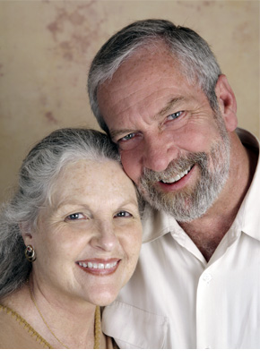
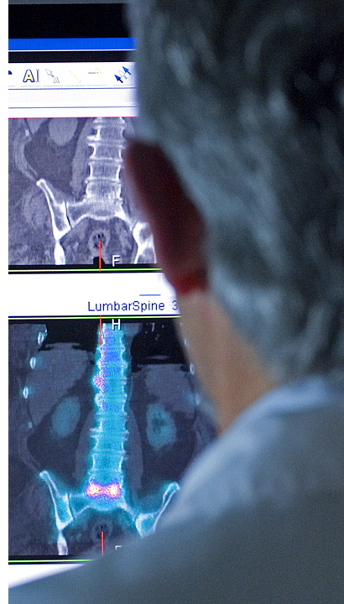
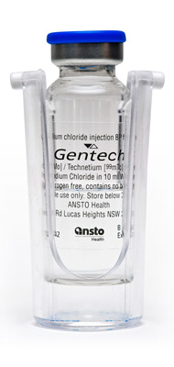
Health
Notes:
Key point - We produce around 85 per cent of all of Australia’s nuclear medicine
ANSTO delivers 10,000 patient doses of vital radiopharmaceutical every week to the Australian health industry, used by medical professionals in the diagnosis and treatment of serious diseases such as cancer
Our researchers undertake ground breaking medical research in areas such as Alzheimer’s Disease, Parkinson’s Disease and Multiple Sclerosis.
Our scientists are undertaking research on the skin secretions of Australian frogs using ANSTO’s time-of-flight neutron reflectometer, Platypus, that could lead to the development of powerful new forms of antibiotics. These could help fight hospital acquired infections that do not respond to some antibiotics.
Australian Nuclear Medicine Project - a $168 million Commonwealth Government and ANSTO project that includes an export scale nuclear medicine manufacturing plant, which will secure Australia’s ability to produce Molybdenum-99 (Mo-99) and increase capacity to meet a significant proportion of the world’s needs, and a collocated Synroc waste treatment plant, which will deliver a permanent, safe and economical way of treating waste from past, current and future manufacture of nuclear medicines.
Photos clockwise from top left: a vial of nuclear medicine produced by ANSTO Health; older couple; Doctor viewing a SPECT/CT (single-photon emission computed tomography/computed tomography ) bone scan; Australian Green-Eyed Tree Frog; family leaving a hospital

Slide 2
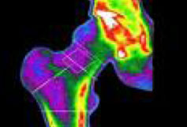
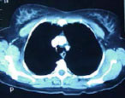
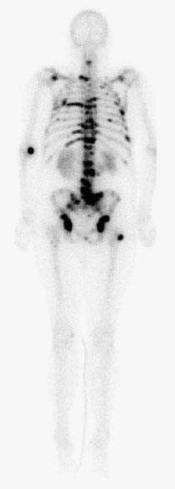
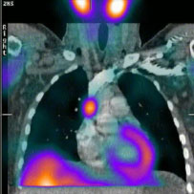
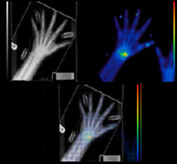
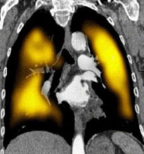
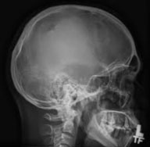
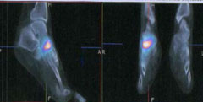
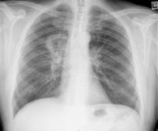
Diagnostic Imaging

Slide 3
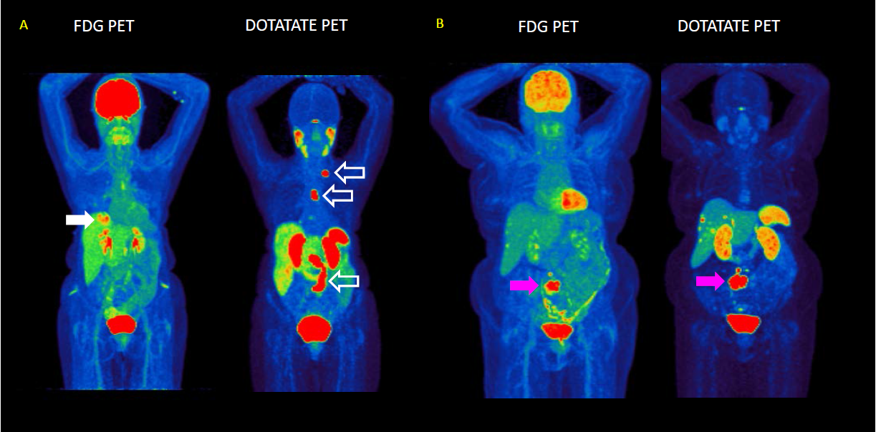
Why do we need different radiopharmaceuticals?

Slide 4
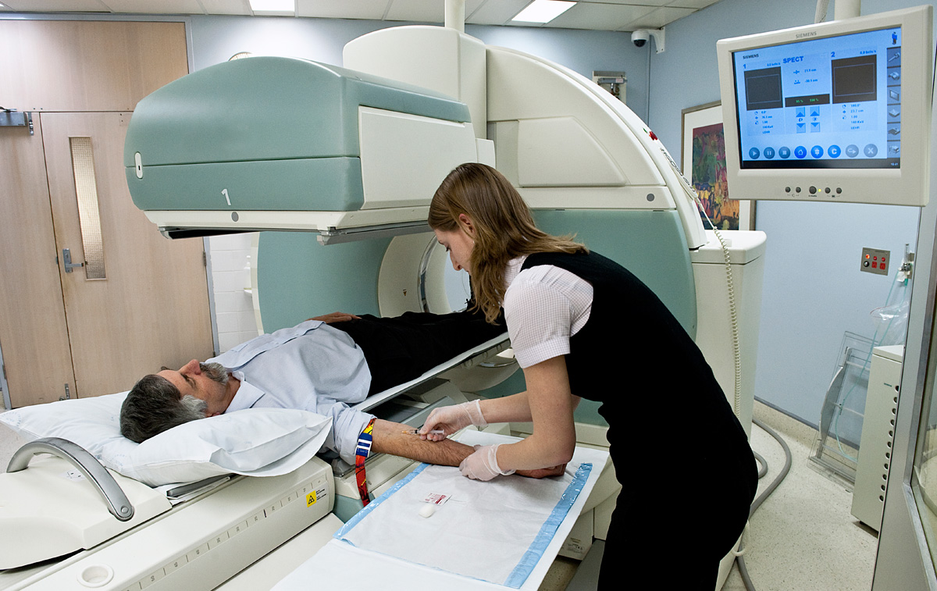
Radioisotope Production
2 million doses of nuclear medicine are manufactured each year at ANSTO
Notes:
2 million doses of nuclear medicine are manufactured each year at ANSTO
Supplying hospitals, radio-pharmacies and private practice
Export LEU/LEU Mo-99

Slide 5
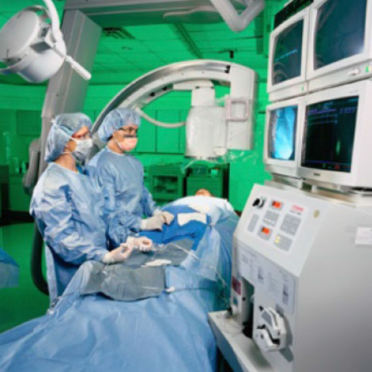
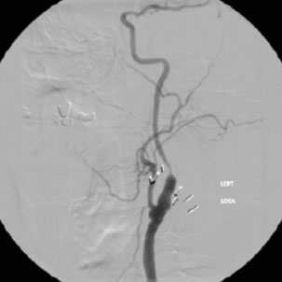
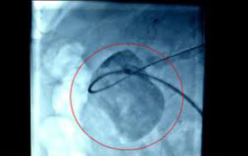
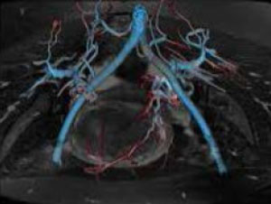
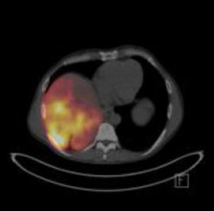
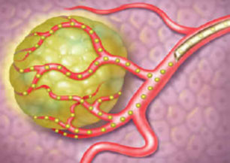
Interventional Procedures

Slide 6
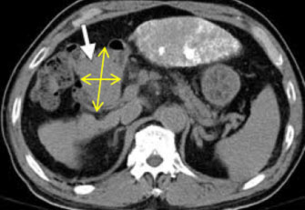
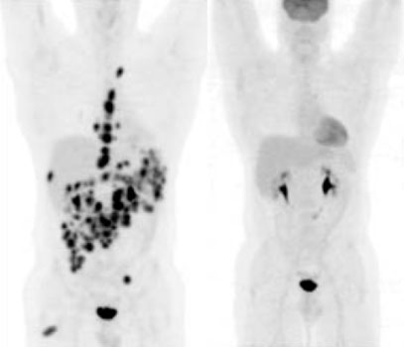
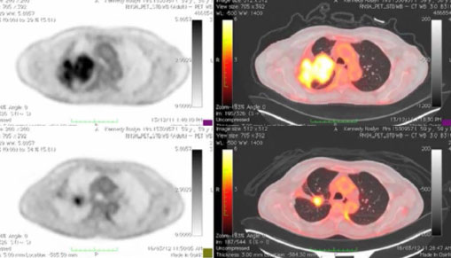
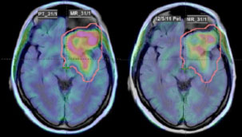
Monitoring Treatment

Slide 7
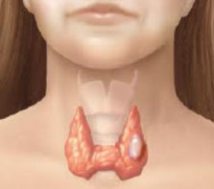
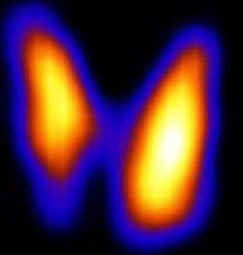
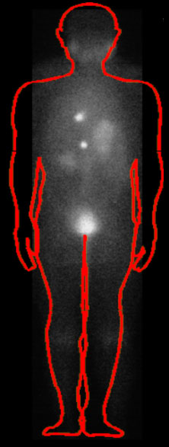
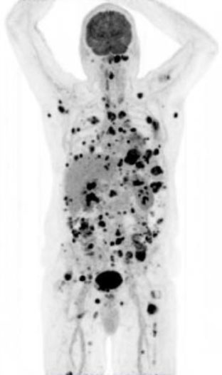
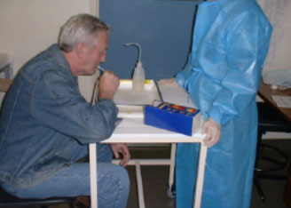
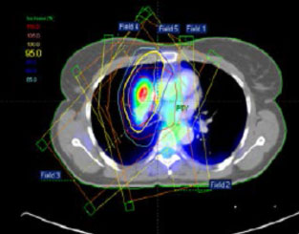
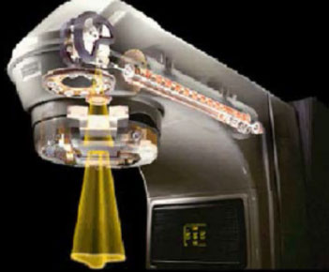
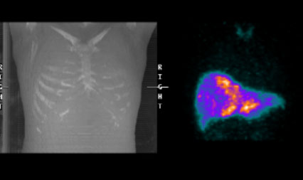
Therapy

