Slide 1
Human Health
How can nuclear techniques contribute to maintaining good health?
1
2
3
Nuclear technology for sustainable health
Biological responses to radiation
Food and nutrition

Slide 2
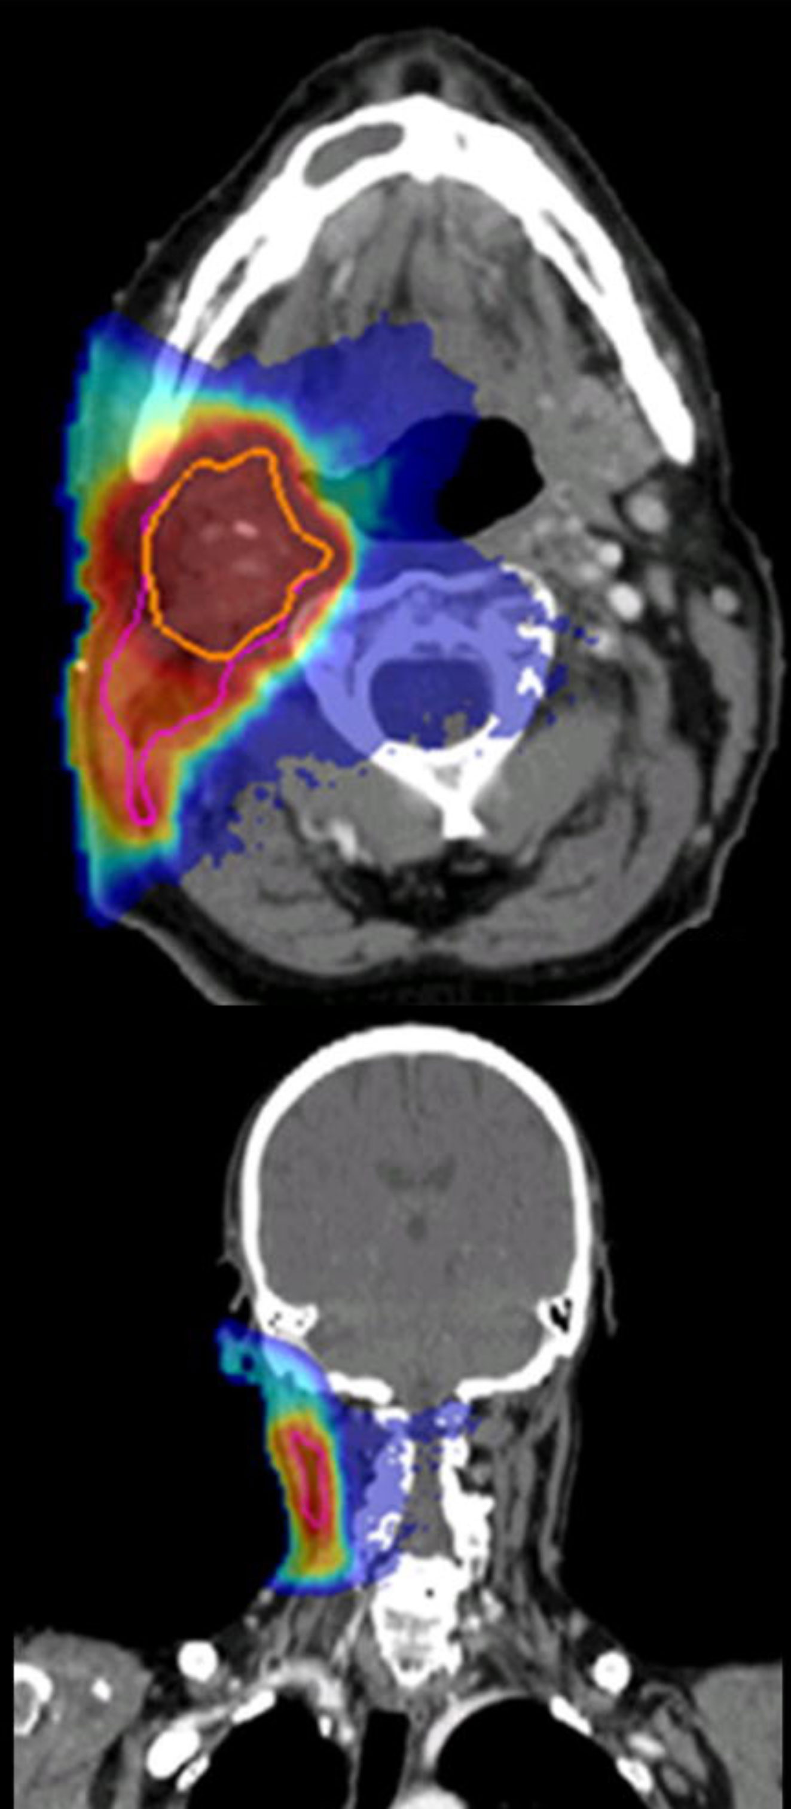
1 | Nuclear technology for sustainable health
How can we maintain good health by harnessing the potential of nuclear techniques?
Complex chronic diseases
Pathways to disease
Radiation therapy optimisation
Early assessment
Therapy optimisation
Notes:
The Nuclear technology for sustainable health program conducts research in those areas where ANSTO’s nuclear and accelerator based assets can have the greatest beneficial impact.
[Pathways to disease focus]
By combining multiple imaging techniques we can track the composition of tissues and cells and directly visualize biochemical activity.
[Early assessment focus]
Early assessment of conditions can be detected with high-sensitivity by PET imaging. The development of a Total-Body ultra-low dose new scanner will bring the PET technology full benefits to new populations, especially asymptomatic and paediatric patients.
PET Explorer will also provide a powerful research tool for unravelling multi-organ diseases such as diabetes, depression, chronic fatigue and mind-body interactions.
[Therapy optimisation focus]
Our expertise in PET radiotracers development is dedicated to increasing their performance and the efficacy of their production. This will provide powerful new capabilities for disease diagnosis and treatment optimization.
We are also developing advanced multi-modal radiotracers which will combine in a single molecule, pre-operative tumour location scanning capability for surgery planning and also fluorescence staining to provide visual cues to diseased tissue areas for surgeon guidance. (for question time or if time permits - alternatively a radiotherapy isotope could be combined with the same tracer molecule to provide targeted, precise, in-situ radiotherapy for cancers in inoperable areas).
[Radiation therapy focus]
Our medical physicists are developing optimized radiotherapies in X-Ray and emerging particle therapy. Research focus on advanced control of radiation beams, and an innovative development of neutron capture enhanced particle therapy process (NCEPT). This will deliver a more effective kill dose to cancer cells while significantly reducing damage to healthy tissues and hence mitigating the severity of side effects.
[Complex chronic diseases focus]
In collaboration with the government of Sri Lanka, ANSTO and collaborators are working towards identifying factors that give rise to a national pandemic of Chronic Kidney Disease of Unknown Aetiology (CKDu).
Our unique combined capabilities and expertise in understanding biological pathways to chronic disease, water quality monitoring and synchrotron microscopic medical imaging will prove invaluable in the fight against this severe disease. (100s of millions of people globally)

Slide 3
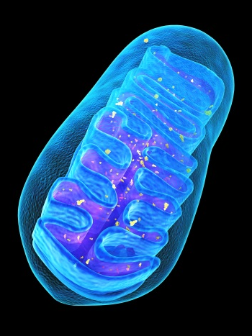
2 | Biological responses to radiation
What is the impact of radiation on biological systems and how can we mitigate it?
Impact
Sensors
Optimisation /mitigation
Notes:
This research program focuses on understanding the impact of low to therapeutic dose radiation on biological systems. Cell response and resilience mechanisms are investigated in partnership with CNES and INSERM. We also develop sensors that can monitor and measure response in vivo, with UNSW. The program aims to deliver mitigation strategies for radiation exposure whether environmental, spatial or therapeutic.

Slide 4
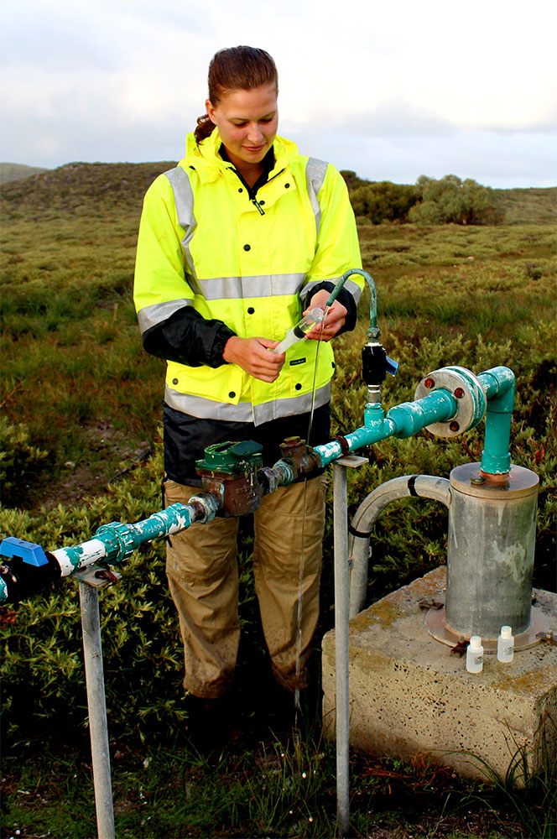
3 | Food and nutrition
How can we improve food structure, production and function to contribute to a better health?
Sustainable production
Sustainable water
Sustainable health
Provenance and traceability
Quality authentication
Nutritional optimisation
Notes:
The research programme leverages from ANSTO strong existing set of techniques and expertise to investigate fundamental and industrial problems of national significance related to food production and consumption.
We generate methods to increase food production sustainability, assess their provenance and traceability to protect consumers and industries. Adding quality authentication is of critical importance, to identify both toxicants and high-value nutrients so that we can optimise food structure and function in order to increase resilience and bring sustainable health.

