Slide 1
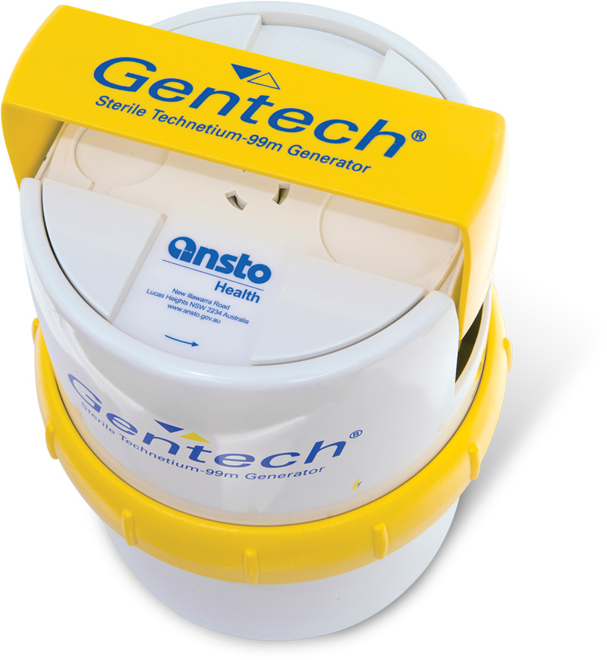
Molybdenum 99
80% of all nuclear medicine procedures use Mo-99/Tc-99m
Key in diagnosing heart disease, cancer, neurological disorders and other conditions
40 million patients per year
Global market of US$550 million p.a.
One in two Australians will benefit from procedure in their lifetime.
Notes:
Technetium-99m is generated from molybdenum-99, which has a half-life of 66 hours, allowing it to be transported over fairly long distances.
Technetium-99 has a radioactive half-life of 212,000 years. Technetium-99m (called metastable Tc-99) decays to Tc-99 primarily by gamma emission, and has a half-life of only about 6 hours. Technetium-99 decays by emitting beta and gamma radiation, to form ruthenium-99, which is stable.
In this case, the nuclear reactor provides the molybdenum for the technetium generator. Molybdenum-99 has a short (66 hour) half-life, and decays to the even shorter-lived Tc-99m.
Central part of ANSTO’s Business is production of nuclear medicines – one in two Australians – 470,000 Medicare

