Slide 1
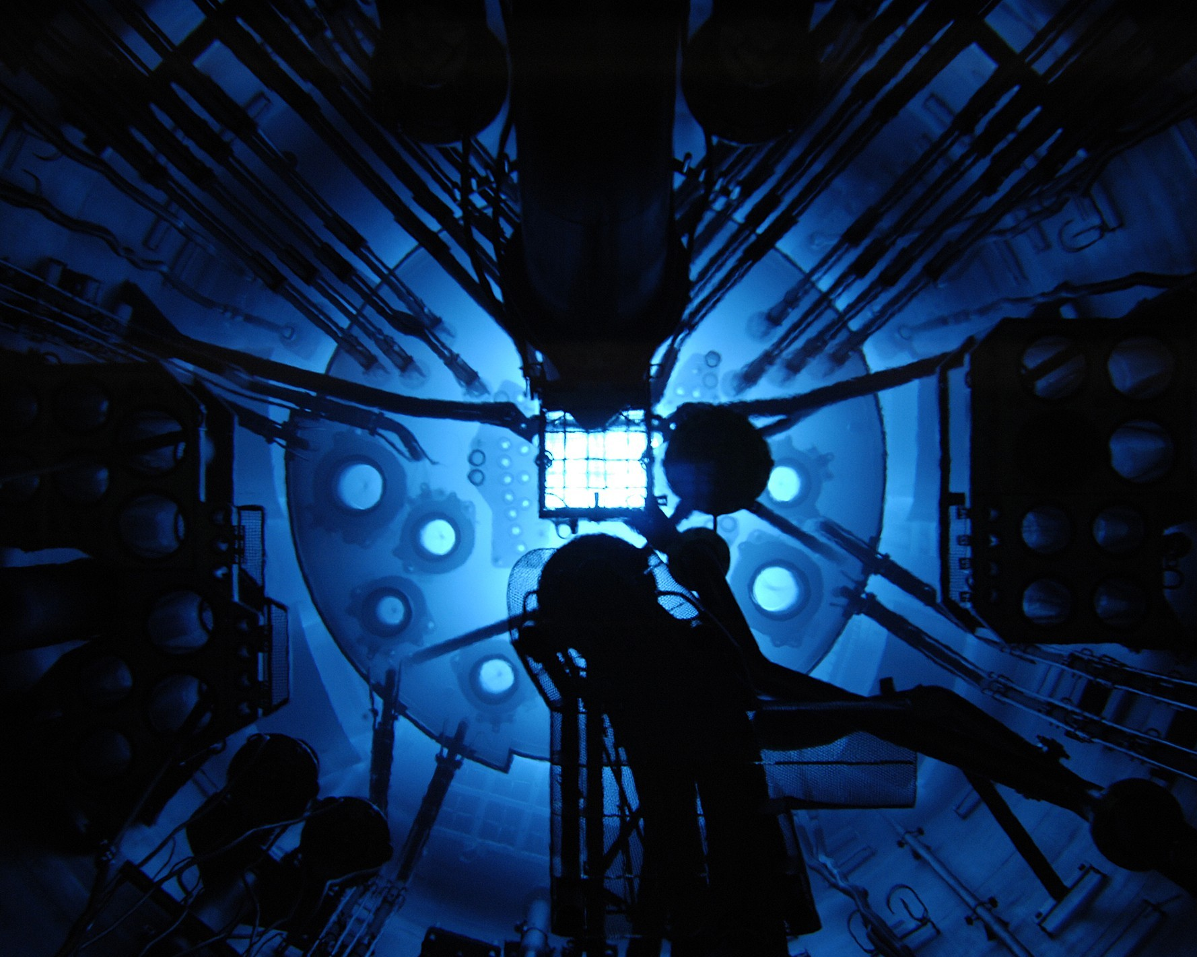
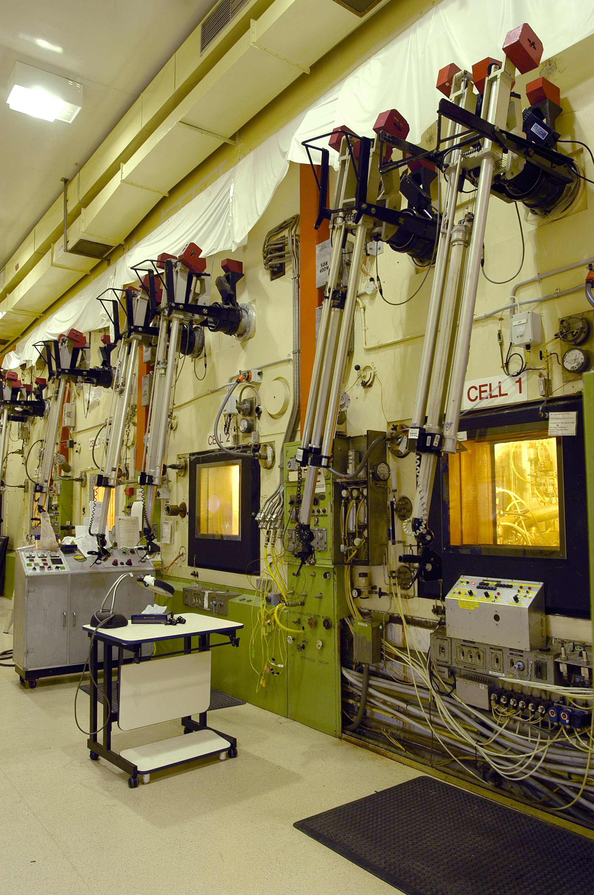
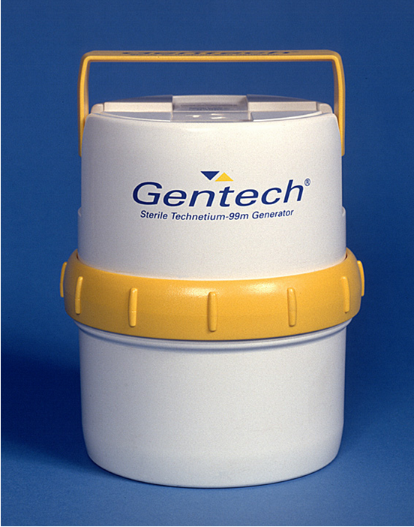
The current production process
LEU in reactor for irradiation & Mo-99 from fission process
Mo-99 separated
Bulk Exports, or
2) Tc-99m Generators to hospitals
Waste immobilised in SYNROC process
Notes:
Australia’s Mo-99 plant must close
Using OPAL, ANSTO currently manufactures 550,000 doses of Mo-99 every year but ANSTO’s manufacturing plant will close by July 2017.
ANSTO’s existing Mo-99 facility was designed and commissioned as a demonstration plant with a life of 10 years.
The existing plant cannot be upgraded because:
The demonstration facility was retrofitted into an existing building and hot cells capable of handling limited amounts of radioactive material with no expansion options. The layout and operation is suboptimal from an efficiency perspective.
A number of critical, high-cost plant and equipment components were designed to operate for 10 years after commissioning. By 2017 these components will no longer be useable. ANSTO’s Engineering and Capital Programs team will need to either shut down or significantly repair and recertify the components.
Given the highly radioactive nature of the material being processed in the existing Mo-99 facility, the facility could not be operated and would have to be completely shut down during the recertification process.
Any replacements or modifications would be inconsistent with best practice OH&S standards
If we are to meet local demand and fill any market gaps in world demand, we must start building a new Mo-99 plant now. It will take 3 years to build new Mo-99 facility and we need time for regulatory approvals etc.
Importing Mo99 is impractical and expensive
Without a local Mo-99 facility, Australia would have to look overseas for Mo-99 supply.
Given the scheduled shutdown of the major overseas production reactors, import at any price might not be possible well within this decade.
ANSTO estimates that Australia would need to spend at least $10 million per year importing this product just to meet current domestic demand.
There are serious logistical impracticalities of importing Mo-99. Mo-99 is a short-lived isotope which becomes unusable after 66 hours once it leaves a reactor.
The cost to the patient/practitioner would increase.
NSTO would have to terminate a key local manufacturing competence that has produced reactor–based isotopes locally for 43 years at a time when global leadership is practical and accessible. Currently, some 45 jobs would be lost directly as a result.

