Slide 1
Energy
ITER and GIF
Global collaborations

Slide 2



ITER: a global collaboration
Notes:
ANSTO’s involvement in the ITER project:
ITER – an acronym which originally stood for International Thermonuclear Experimental Reactor – also means the way in Latin.
It is quite simply one of, if not, THE biggest scientific engineering projects in the world.
Situated in southern France, ITER holds the promise of unlimited energy by replicating fusion – the nuclear reaction that powers the Sun and stars, and a potential non-carbon emitting, limitless energy source.
The ITER project is a global initiative involving seven member entities– the European Union, India, Japan, China, Russia, South Korea, and the United States – comprises more than 35 countries … and as of last year, Australia is involved as a result of ANSTO.
In 2016, ANSTO officially signed an agreement with the Director-General of the ITER International Fusion Energy Organisation to join this international consortium of countries involved in the project … but our involvement does not involve construction and unlike the member entities, did not involve a large investment.
The member entities, who are all financial, paid partners and investors in the initiative, have been hard at work for some time now – since construction started in 2006 – building the componentry in their home countries for shipment to France, to the ITER site, for assembly.

Slide 3
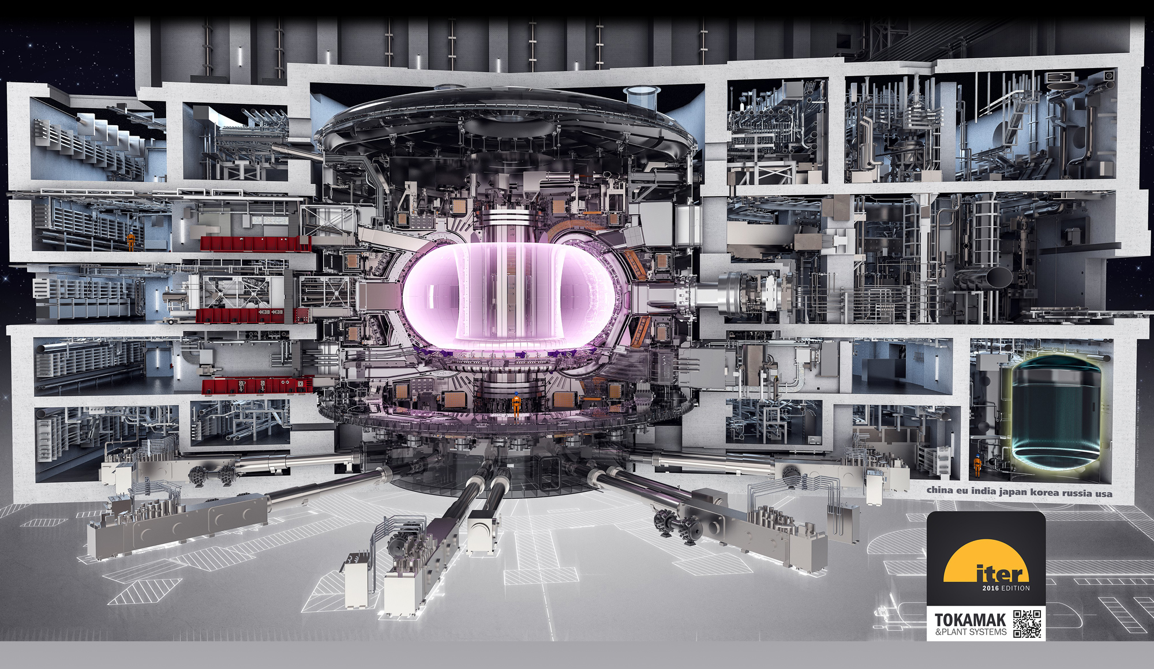
Tokamak complex
Notes:
The sheer size, numbers and scale of ITER is mind-blowing. The ITER machine will weigh 23,000 tonnes and will dominate the 180-hectare site.
The Global Fusion Energy project centres on the construction of the world's largest tokamak, a magnetic fusion device or reactor, which harnesses the energy of fusion and captures this heat in the walls of the vessel. The weight of the Tokamak is equivalent to three Eiffel Towers. The structure of the central solenoid – the electromagnet in the centre of the machine – must be strong enough to contain a force equivalent to twice the thrust of a Space Shuttle at takeoff.
100,000 kilometres of superconducting strands are necessary for ITER's toroidal field magnets. Stretched end to end, the strands produced for ITER would wrap around the Earth at the equator twice.
Thousands of engineers and scientists have contributed to the design of ITER.
Construction started at the ITER facility in 2007 with an expectation of first plasma – or criticality – in 2025.
Central to the initiative is the Tokamak – this slide shows a cross section of the facility.
It is a seven-storey structure that will, as has been described “put the power of the sun in a box”.
A tokamak - devised and invented in Russia during the 1950s – uses powerful magnetic fields to confine the plasma in a torus or donut shape. Just like a conventional power plant, a future fusion power plant will use this heat to produce steam and then electricity by way of turbines and generators.
The difference is there are no harmful greenhouse-gas emissions as a result, and very low levels of radioactive waste.
Magnetic fields are used for the confinement since no solid material could withstand the extremely high temperature of the plasma – about 200 million degrees.
And that’s where ANSTO’s involvement comes into play and I’ll talk more about that shortly.

Slide 4







ANSTO’s role
Notes:
ANSTO, as the first non-member entity to be involved, has been engaged in an intellectual capacity … for our expertise in nuclear engineering and project management capability.
Our involvement provides Australia with the same research benefits of member entities … and ANSTO will act as a conduit to allow all relevant Australian researchers to engage with ITER.
Already we have six universities on board as partners, including ANU led by Professor John Howard – a stalwart in the fusion space.
ANSTO and ANU, with support from ITER, are planning to construct and install a unique plasma imaging device inside the reactor. We will combine ANU’s plasma imaging experience with our expertise in nuclear engineering to develop an important diagnostic for the ITER project.
More broadly … ANSTO’s involvement in ITER and role as conduit for researchers has opened the door for related opportunities and areas for exploration.
We are in discussion for further materials collaboration with ANU … and a novel superconductor project with the University of Wollongong.
And this is just the beginning with potential to work with other partner universities already involved.
This is a long term and game-changing project which represents the Holy Grail for global energy production … based on the same principle that powers our Sun and stars.
If achieved at a large-scale, fusion power would answer some of the world’s issues and questions related to sustainability, climate change and security … through the supply of limitless clean energy.
[Recently, ANSTO, on behalf of Australia, signed the first ever technical cooperation agreement between ITER and a non-ITER member country, giving Australia access to this energy megaproject. The agreement clears the path for ANSTO, Australian universities, and other Australian research organisations to contribute their unique expertise to the ITER project. In return they benefit from collaborating with the minds and institutions leading the world in fusion research and all its related disciplines. ]

Slide 5
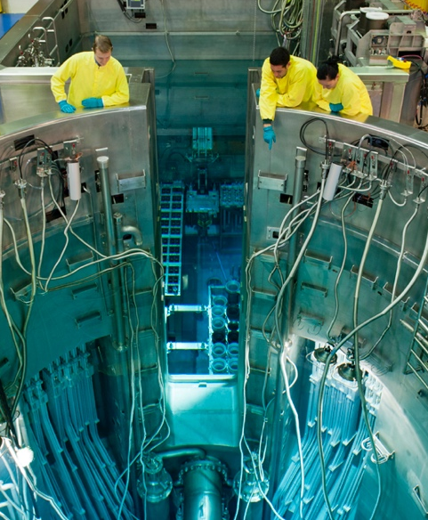
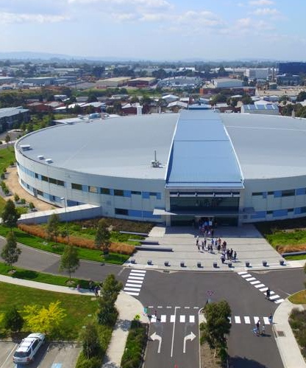
ANSTO’s unique capabilities

Slide 6
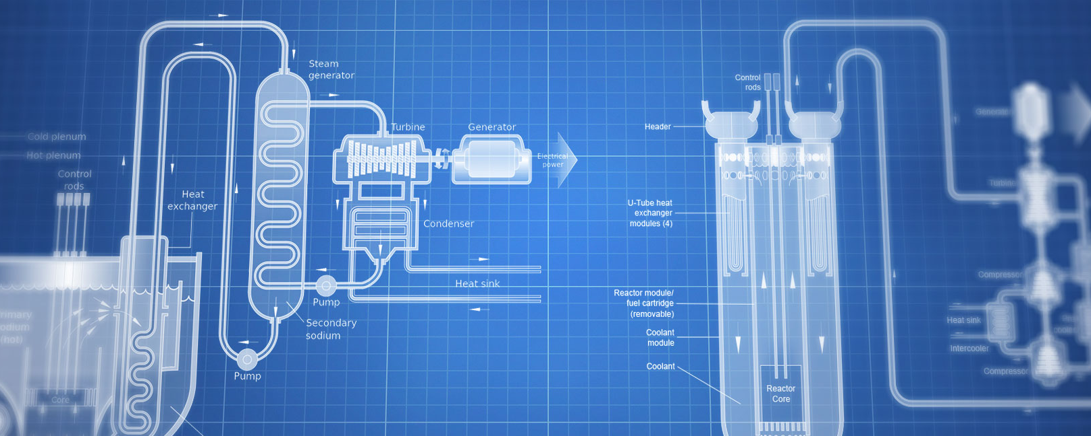

Generation IV International Forum (GIF)
Notes:
In June 2016, following a multinational process, ANSTO signed the Generation IV International Forum (GIF) charter. This is a consortium of 14 countries committed to working together in long-term research on advanced nuclear technologies.

