Slide 1
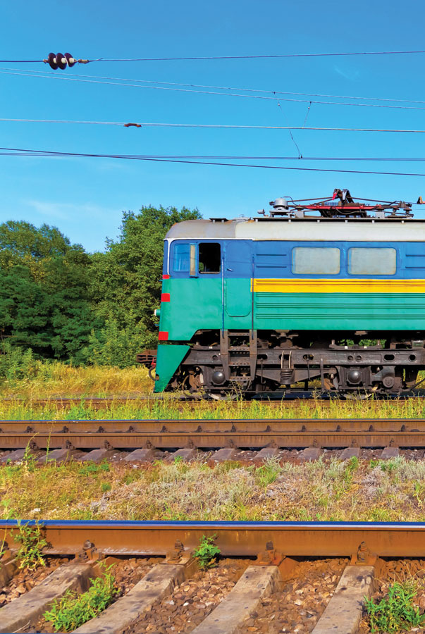
Helping keep our railways safe
Problem
Rail squats or cracks can quickly become dangerous and are a major concern for rail authorities around the world.
Approach
Using neutron diffraction, squats were tested providing information about their structure and how far atoms can be stretched apart, identifying how and where a material may potentially break.
Benefit
The research could improve the manufacturing and service of rail tracks.
Collaborators RailCorp and The University of Queensland
Notes:
Helping to keep our railways safe
Australia’s rail industry is benefiting from nuclear techniques, which are being used to solve the problem of rail squats or cracks in the rails. While typically starting as minor abnormalities, rail squats can quickly turn into dangerous vertical cracks and are a major source of concern for rail authorities around the world.
Scientists are studying squats using a technique called neutron diffraction, which provides information about the structure of materials and how far atoms can be stretched apart.
In what is called a stress test, a sample is placed in a neutron beam at ANSTO’s Bragg Institute to obtain a diffraction pattern that provides information about the structure of the material. Through this test, scientists and experts can identify how and where a material may potentially break.
It is hoped that this research, which is being jointly conducted by ANSTO, RailCorp and The University of Queensland, will lead to a better understanding of rail squats and improve the manufacturing and service of rail tracks.

