Slide 1
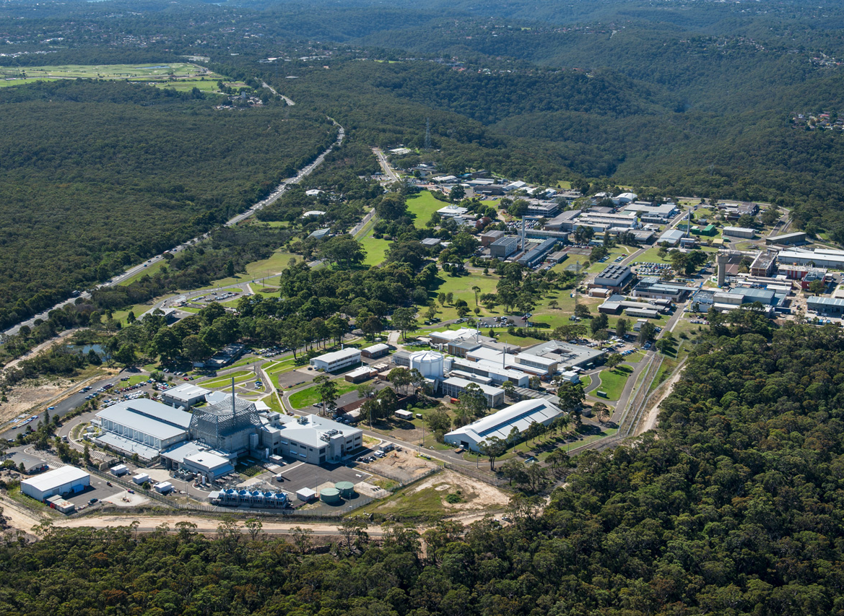

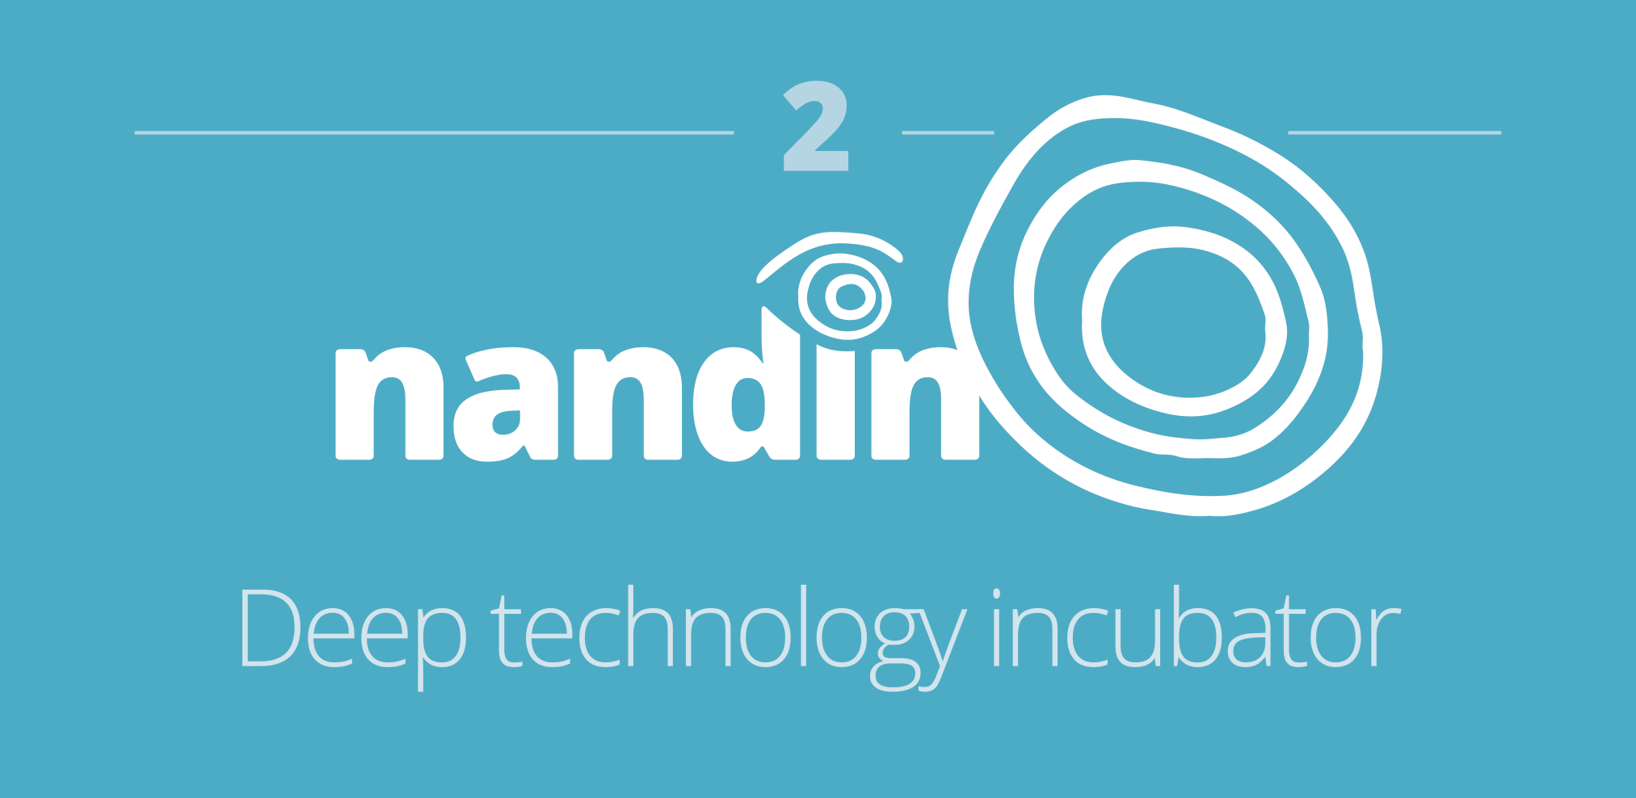


Innovation

Slide 2











































University connections
1
Graduate
Institute

Slide 3
Innovation

Slide 4

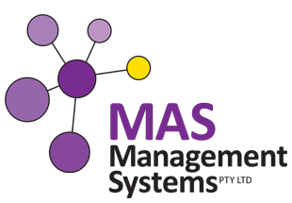



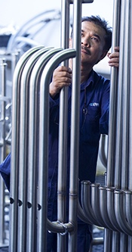
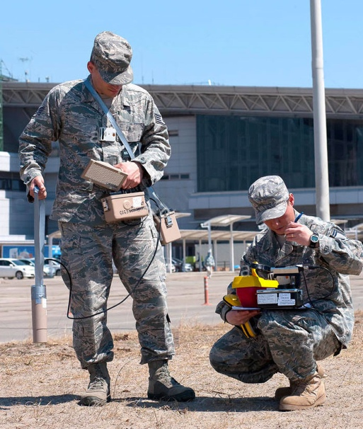

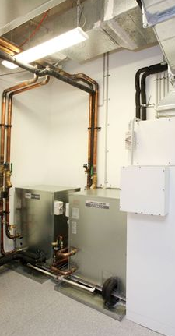



First members of pilot
2
nandin
Deep Technology Incubator
Notes:
For example:
Enware Australia Pty Limited
Enware is an established (almost 200 employees) advanced manufacturing (plumbing) and smart technology company based in Southern Sydney. Enware is looking to expand their research and development activities in collaboration with ANSTO scientists, research infrastructure and business development team.
Given the rise of the competing manufacturing market in Asia for everyday plumbing supplies, Enware has differentiated itself in the manufacturing market through the development of smart plumbing technologies. Examples include intelligent water control systems for hospitals, aged care facilities and prisons.
Amentum Pty Ltd
Amentum Defence and Security is a startup which works in the nuclear security, counter proliferation and defence sector. It produces radiation protection products for use in defence.
Amentum was originally based in Melbourne, but has moved to Sydney to grow the business by working with ANSTO at the Nandin Innovation Centre.
Amentum, with ANSTO support, is currently applying for defence innovation grants from the Federal Government to support aspects of their work.
Crypsis
Crypsis is a Sydney-based startup which is developing advanced cyber security threat detection and analytics tools.
Crypsis’ motivation for locating at the Nandin Innovation Centre is to learn from ANSTO’s real-world expertise in cyber security. Understandably, the cyber security arrangements for the OPAL reactor are unique to the Australian setting and are widely considered by the nuclear security community as world-class.
Bioair:
BioAir (https://bioair.com.au/) – an Australian company who are commercialising GPAC (Gas Phase Air Cleaning) an air conditioning augmentation system designed to enhance air quality and reduce energy consumption and costs. The technology was developed at the ANU.
MAS Management (https://www.masmanagementsystems.com.au/)
a chemical metrology and laboratory accreditation management consultancy business. They are currently developing machine learning solutions for data management and legal compliance to assist organisations in laboratory accreditation.
Hyron Scientific Pty Limited
A medical device start up looking at commercialisation of single use medical device for lung function testing.

Slide 5
Innovation

Slide 6
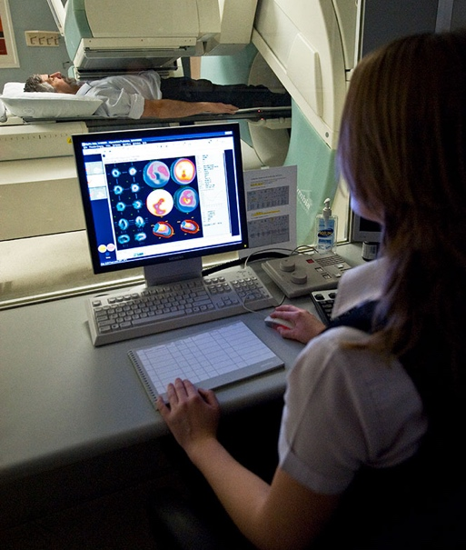

Anchor Tenants
3
Technology
Park

Slide 7
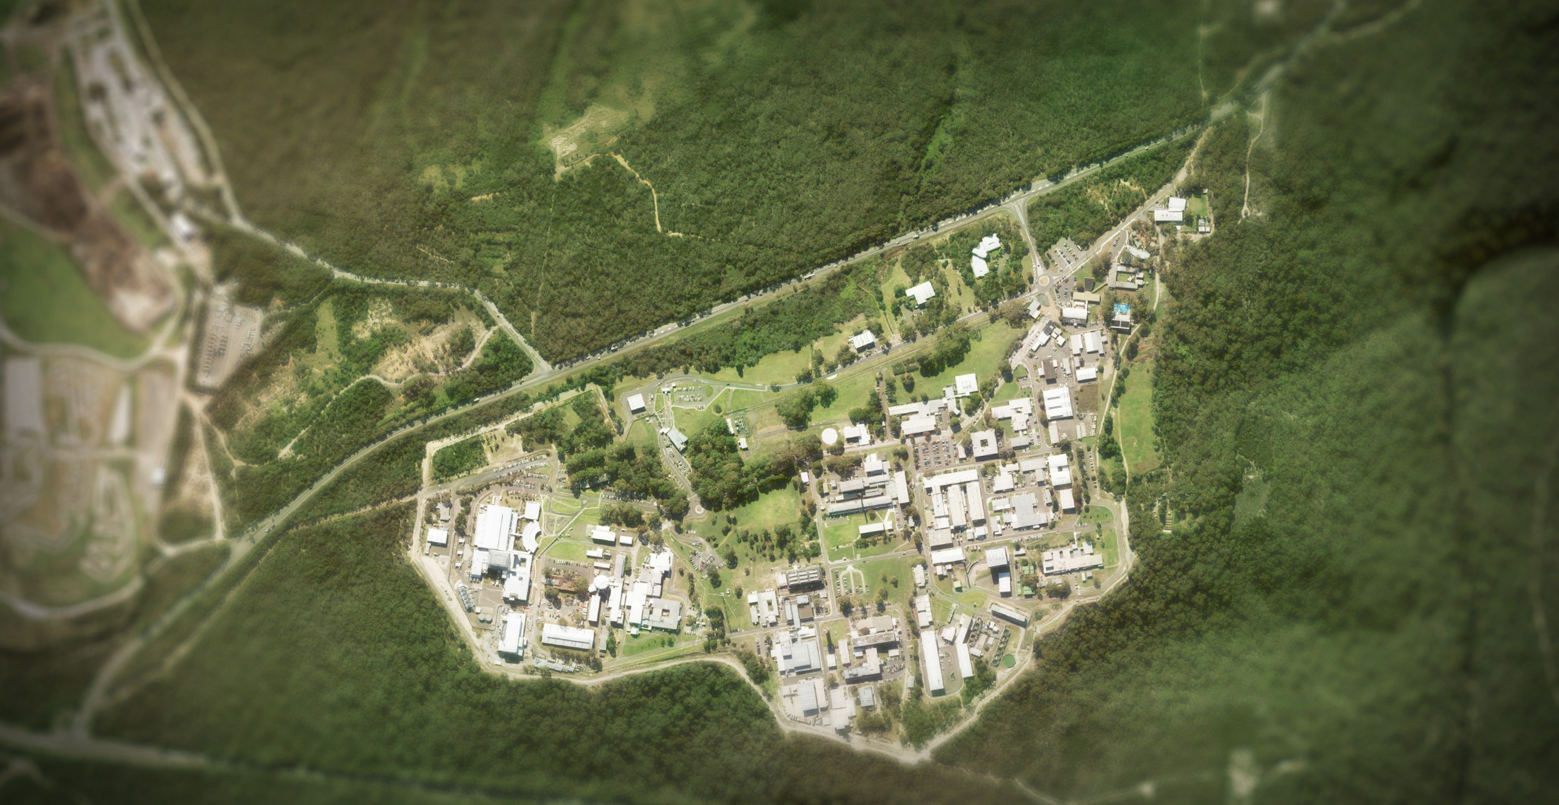
Concept
Concept plan
CURRENT SITE
Innovation

Slide 8
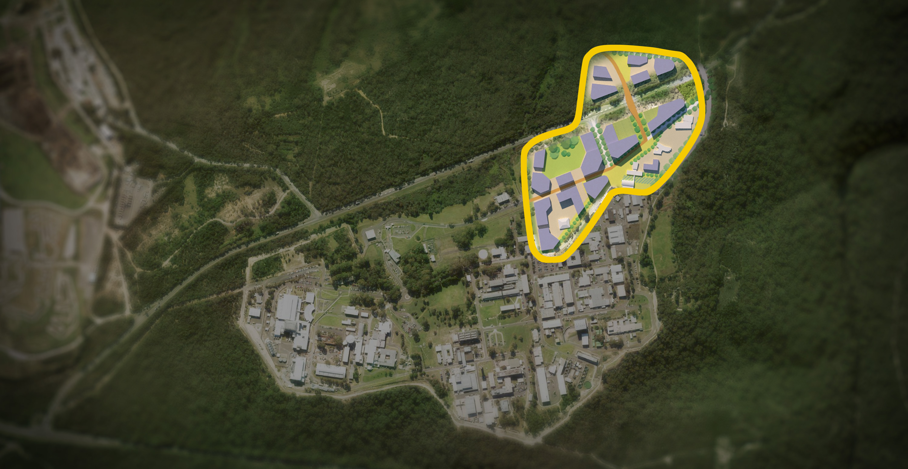
Concept
Concept plan
PHASE ONE
Innovation

Slide 9
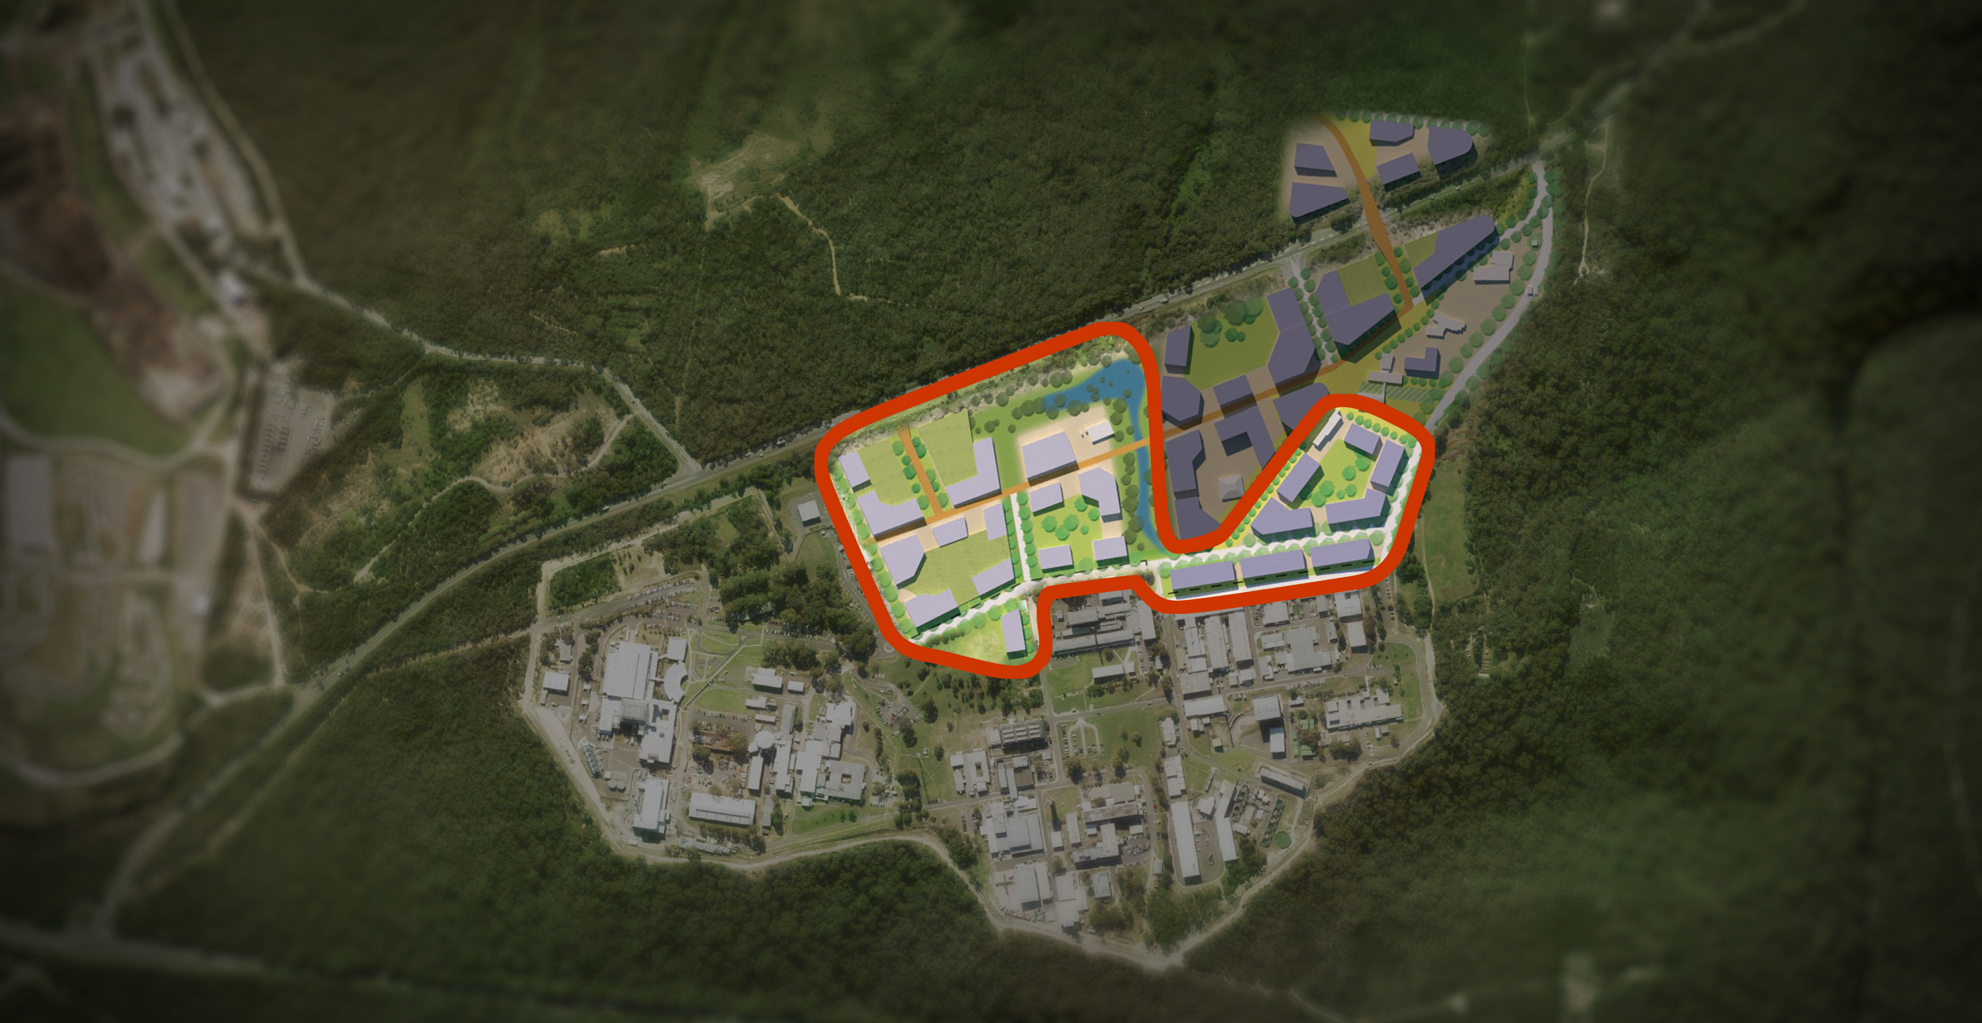
Concept
Concept plan
PHASE TWO
Innovation

Slide 10
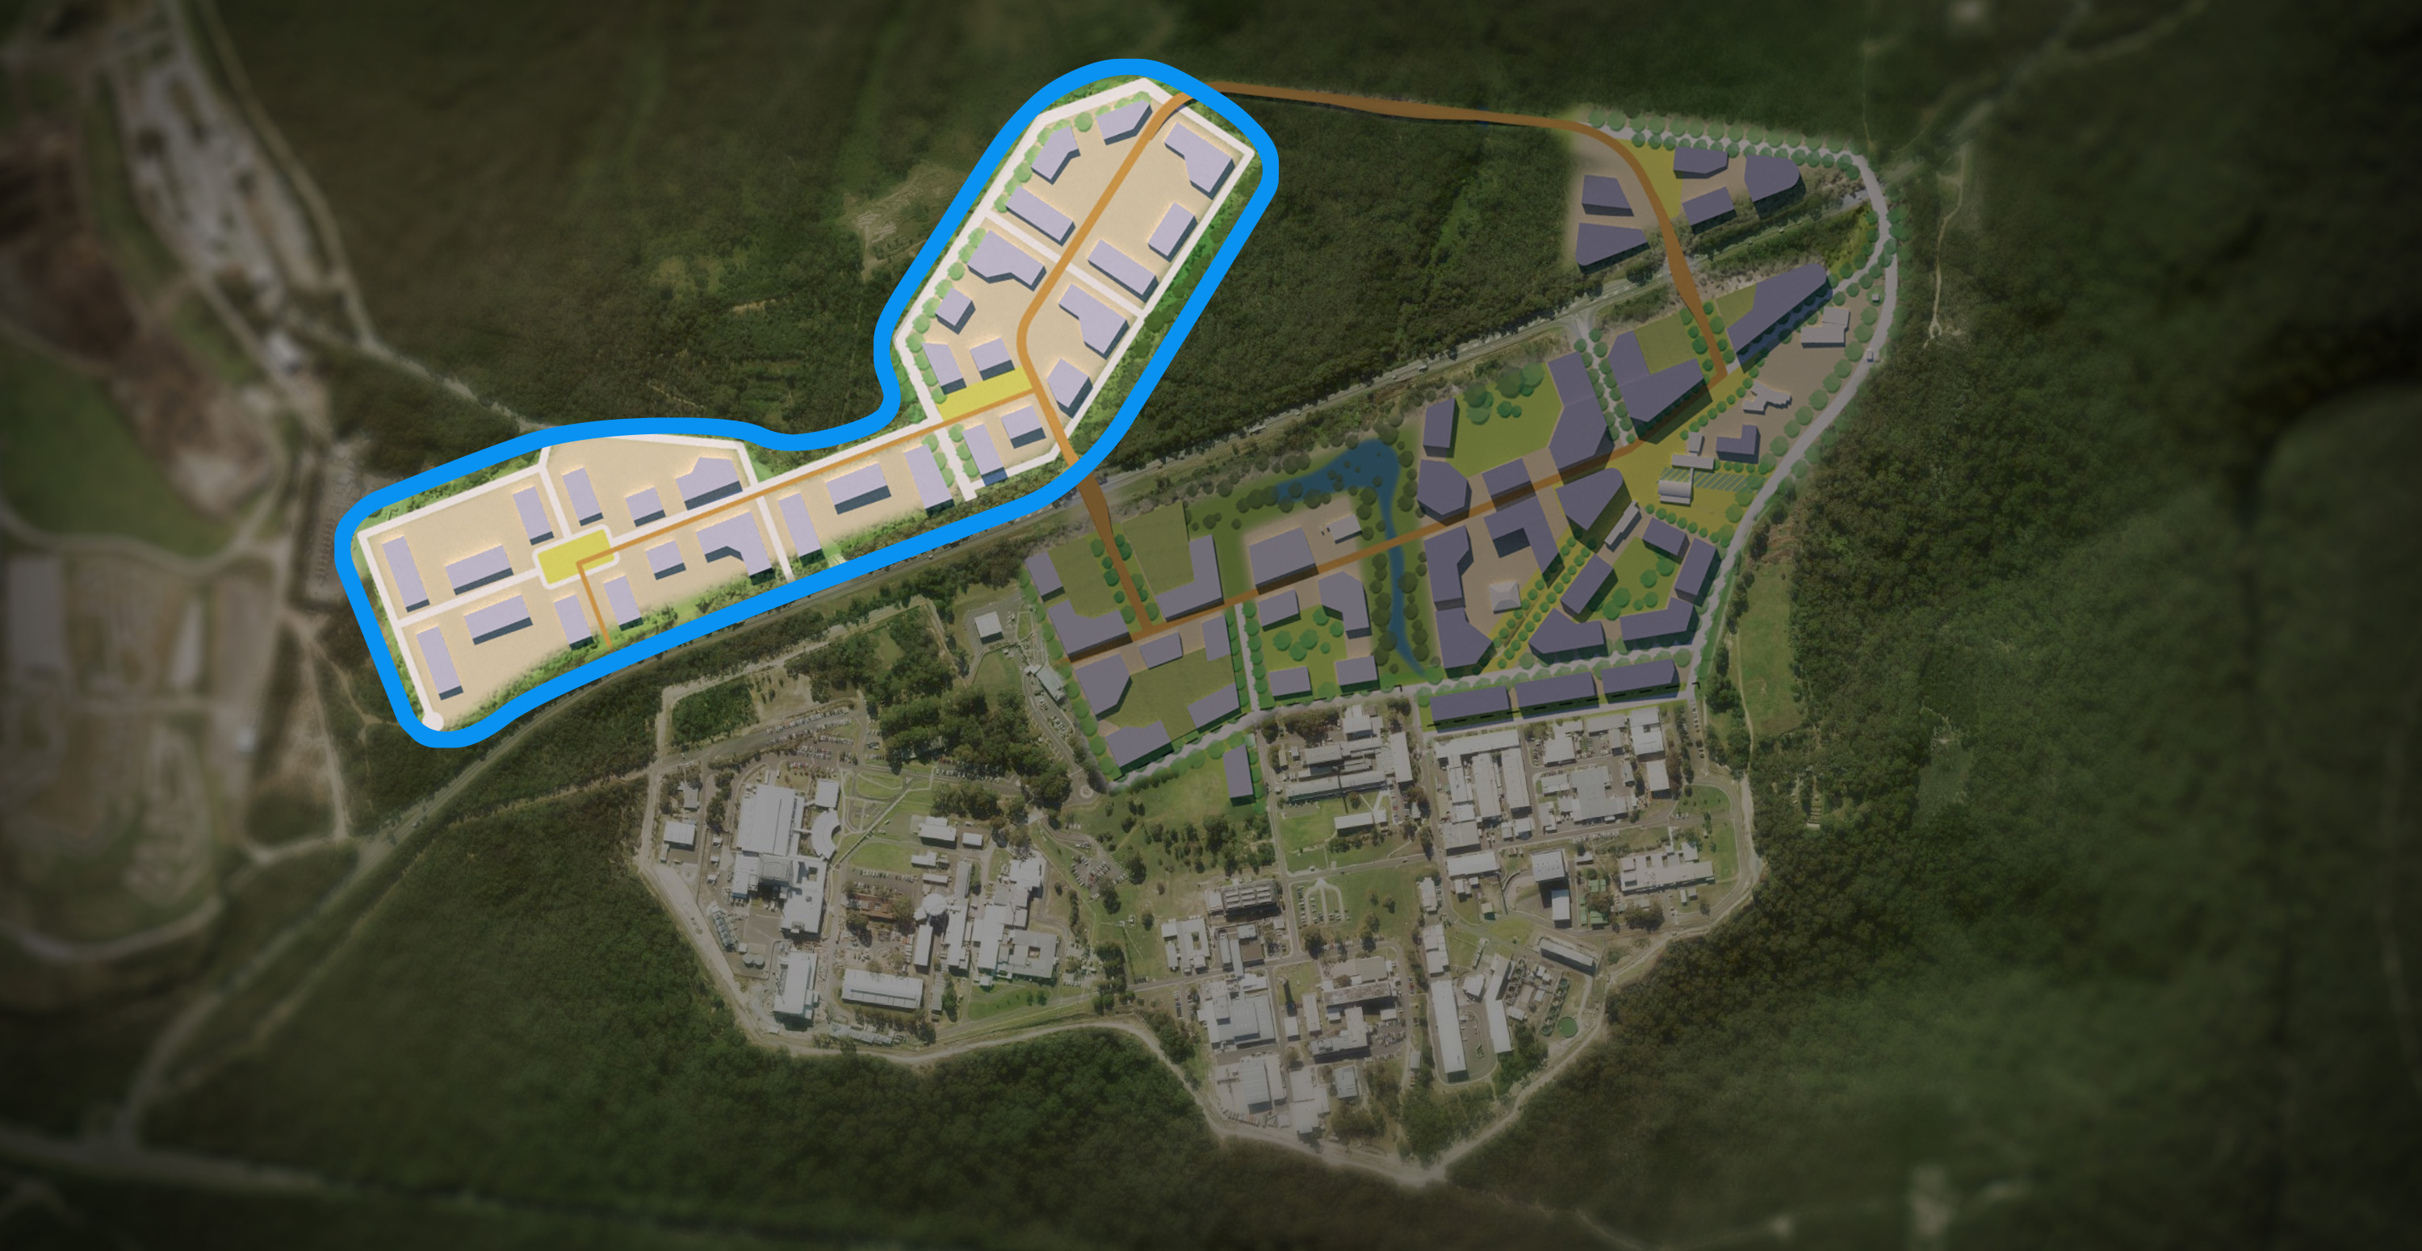
Concept
Concept plan
PHASE THREE
Innovation

Slide 11
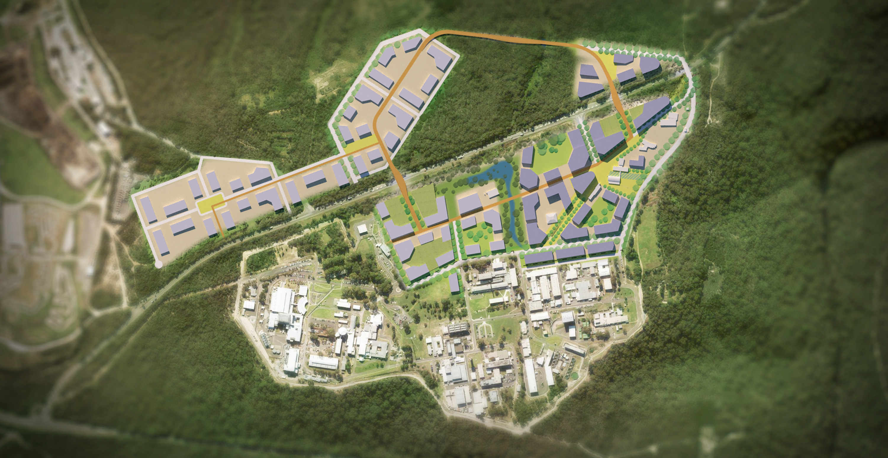
Concept
Concept plan
Innovation

Slide 12


GIANT Innovation Campus
Grenoble, France

Slide 13
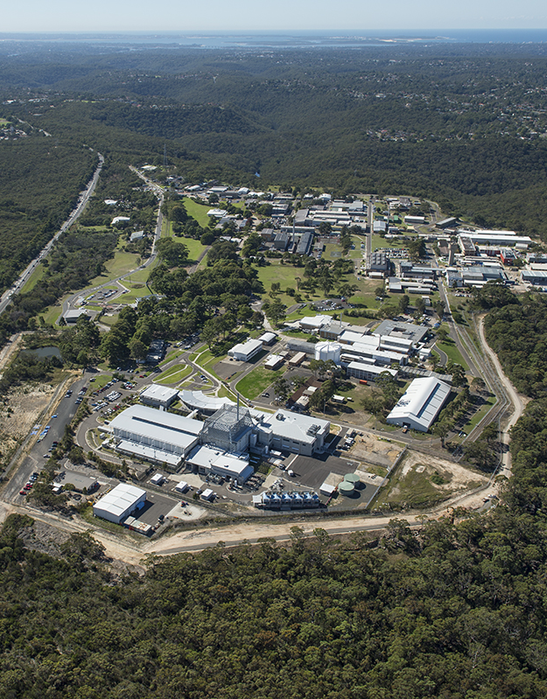
International landing pad

Slide 14
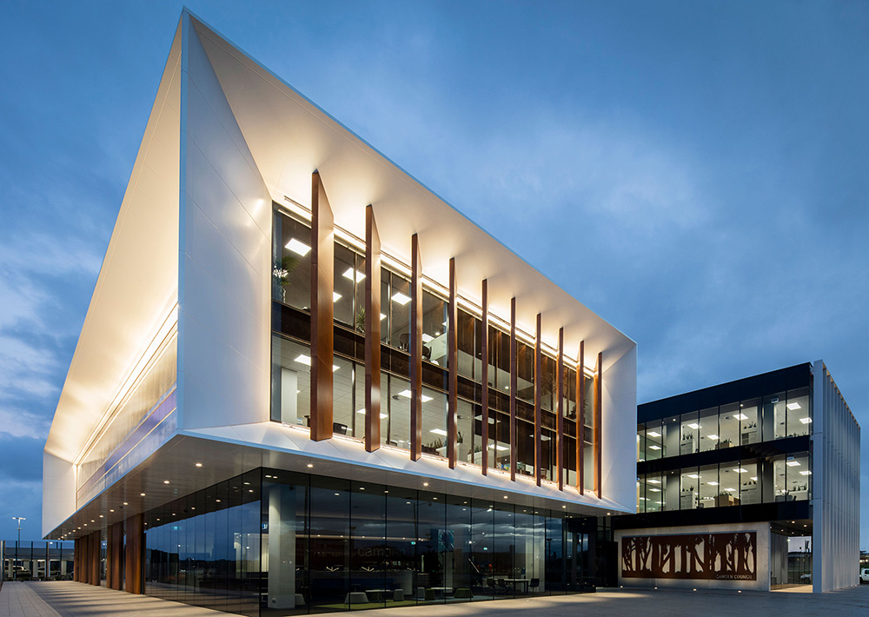


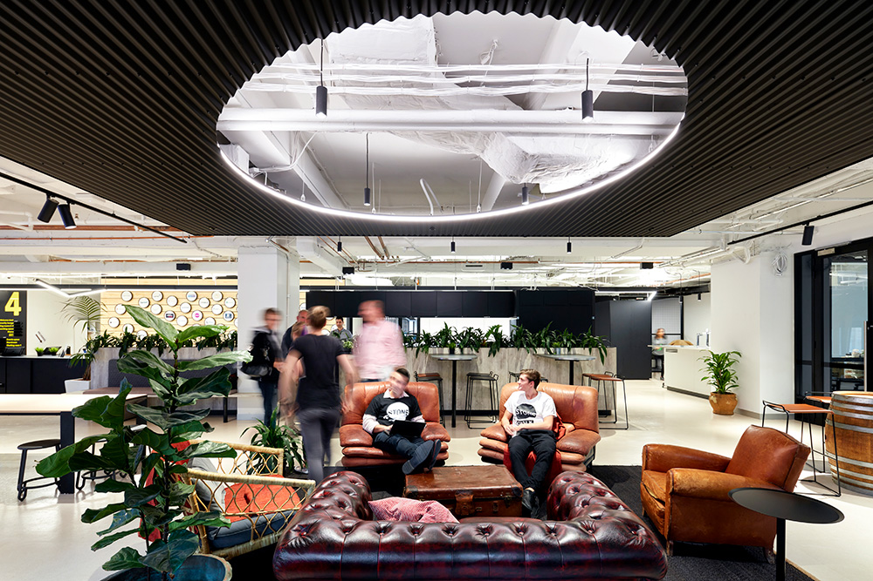
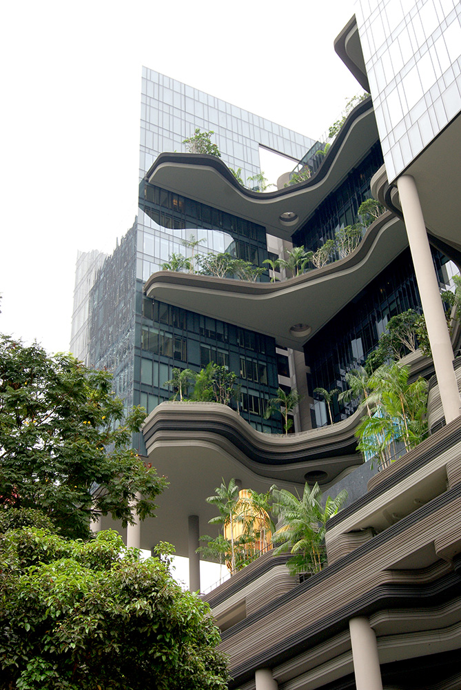
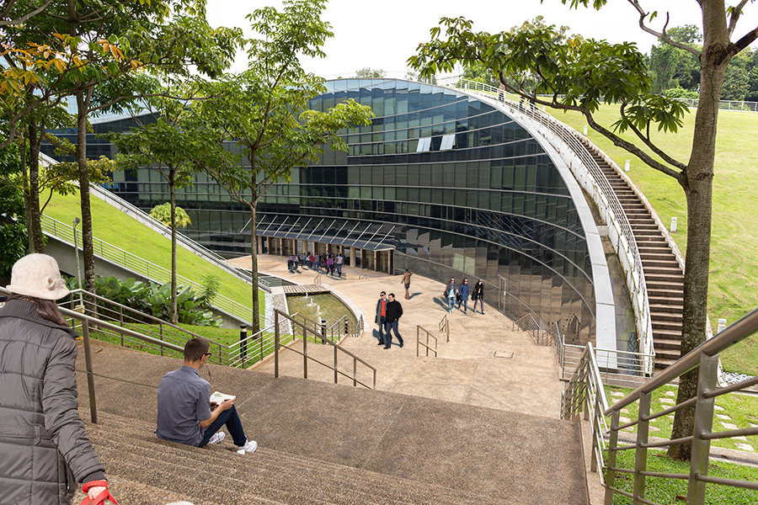




Innovation Precinct

