Slide 1
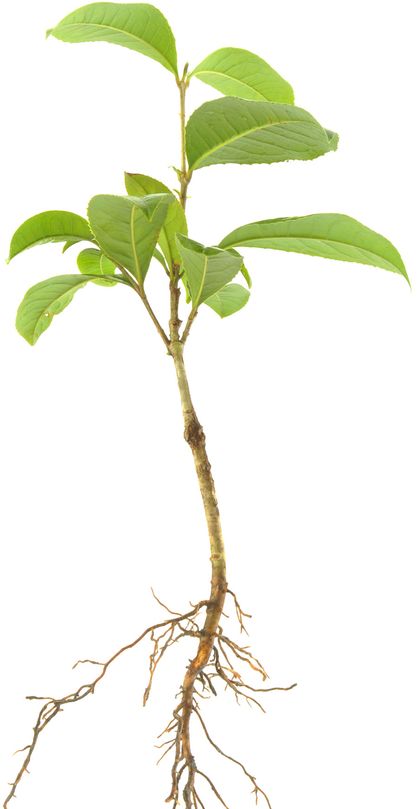
Really ‘green’ technology
Problem
Many soils are contaminated with metals, affecting agriculture, human health and the environment.
Approach
Some plants have the potential to remove metal contamination from soils. Measuring the elemental distribution using microanalytical techniques can help understand the strategies plants employ to tolerate high concentrations of metals.
Benefit
The research could help develop methods for repairing contaminated soils.
Notes:
Really ‘green’ technology
A ‘green technology’ of the leafy variety developed by ANSTO could potentially remove metal contamination from soils and deliver a boon for the agricultural sector and benefits for human health and the environment.
Microanalytical techniques provide new insight into the understanding of biological and environmental processes, such as metal hyper-accumulation in plants.
Measuring the elemental distribution in different plant tissue types, such as leaves, stems and roots can help us understand the strategies plants employ to tolerate high concentrations of metals, such as nickel and cobalt.
Some plants have the potential to be used to remove metal contamination from soils, a process known as phyto-remediation, and help
repair contaminated environments.

