Slide 1
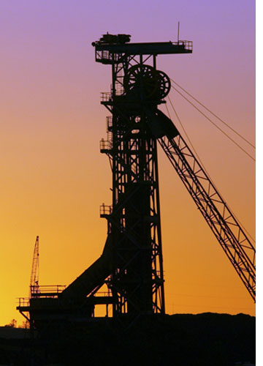
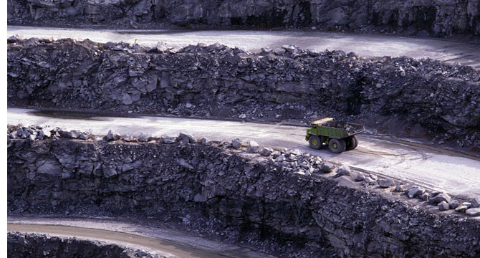
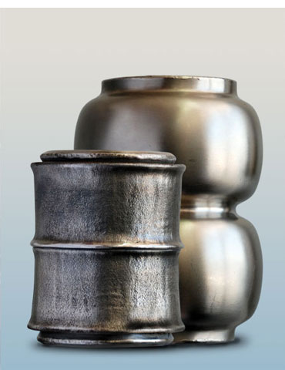
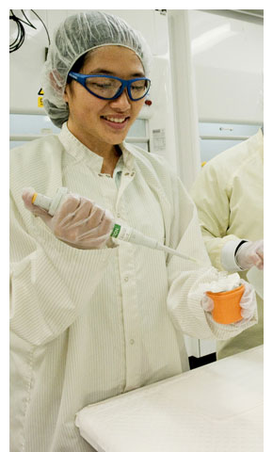
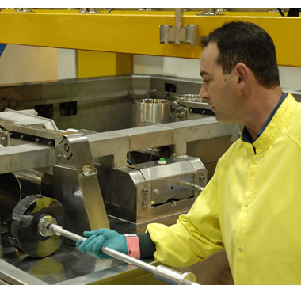
Supporting industry
Notes:
Key point - We have partnered with the mining industry for 30 years
ANSTO’s expertise is employed by many different industry groups
For over 30 years, ANSTO Minerals has been a lead consultancy for the uranium and rare earths mining sector.
ANSTO’s highly successful silicon irradiation business provides silicon used in high end electronic devices such as a hybrid cars and highspeed
trains.
Through our irradiation facility GATRI (Gamma Technology Research Irradiator), we provide a comprehensive range of irradiation services to sterilize items for medical, health, industry, agriculture and research purposes
Our Business and Commercialisation team provides a conduit for industry to work with our scientists to develop new products
Our Synroc (synthetic rock) technology, developed by ANSTO, uses naturally occurring minerals that safety lock up radioactive waste
An ANSTO invention, Rapid Visco Analyser or nRVA, could revolutionise food manufacturing processes by allowing manufacturers to make food more efficiently, with lower energy input and offer health benefits like helping counter bowel cancer
Most Australians own at least one Li-ion battery, usually in a device such as a mobile phone. Research by our scientists, using neutron diffraction, is helping to improve the performance of these batteries
A new software program developed by our researchers is being quickly snapped up by coal-fired power stations across the country to help improve their efficiency. The software, ‘RemLife’, gauges the wear and tear of plant infrastructure and calculates the damage a power plant sustains during its operating cycle which allows prediction of how much longer plants can operate safely
Photos clockwise from top left: Drilling rig; handshake; open cut mine; operator loading a silicon ingot into the double transfer unit located on the side of the OPAL service pool; ANSTO Health staff member testing a nuclear medicine finished good; Hot-isostatic Pressing (HIP) technology sliced bread

