Slide 1
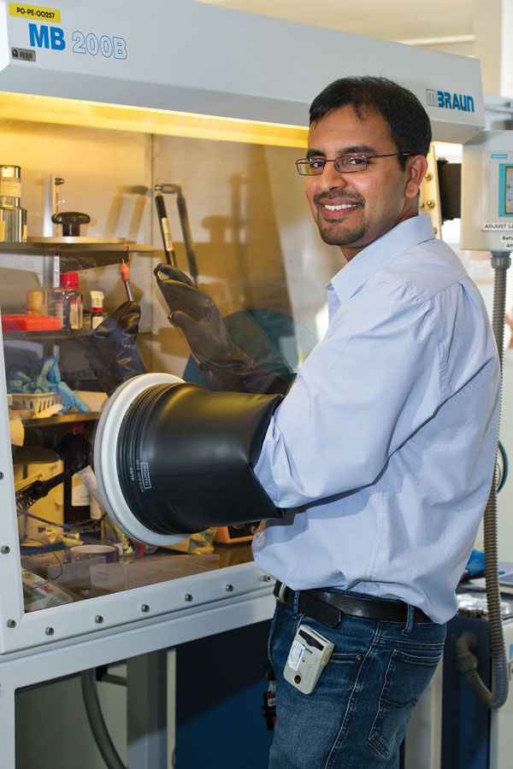
The potential of battery power
Problem
Lithium batteries could provide an infinite power source for electronic devices however a number of factors inhibit their performance during charge and use.
Approach
Using neutron diffraction, ANSTO studied what happens at the atomic-scale within Li-ion batteries components during discharge and re-charge.
Benefit
The research could help improve the shelf life of this power source and lead to new uses.
Neeraj Sharma preparing samples in a glove box.
Notes:
The potential of battery power
In theory, lithium batteries should run forever providing an infinite power source for our electronic devices and potentially one day - electric cars. The problem is that a number of factors inhibit their performance during charge and use.
ANSTO is analysing the fundamental properties of lithium, also known as Li-ion batteries, of the kind that most of us have in mobile phones, portable media players, or laptop computers.
The ANSTO research undertakes neutron diffraction using the Wombat and Echidna neutron scattering instruments to learn what happens at the atomic-scale structure to the components within Li-ion batteries during discharge and re-charge.
ANSTO’s research into Li-ion battery performance could help improve the shelf life of this versatile power source and provide insights that may lead to their broader applications.

