Slide 1
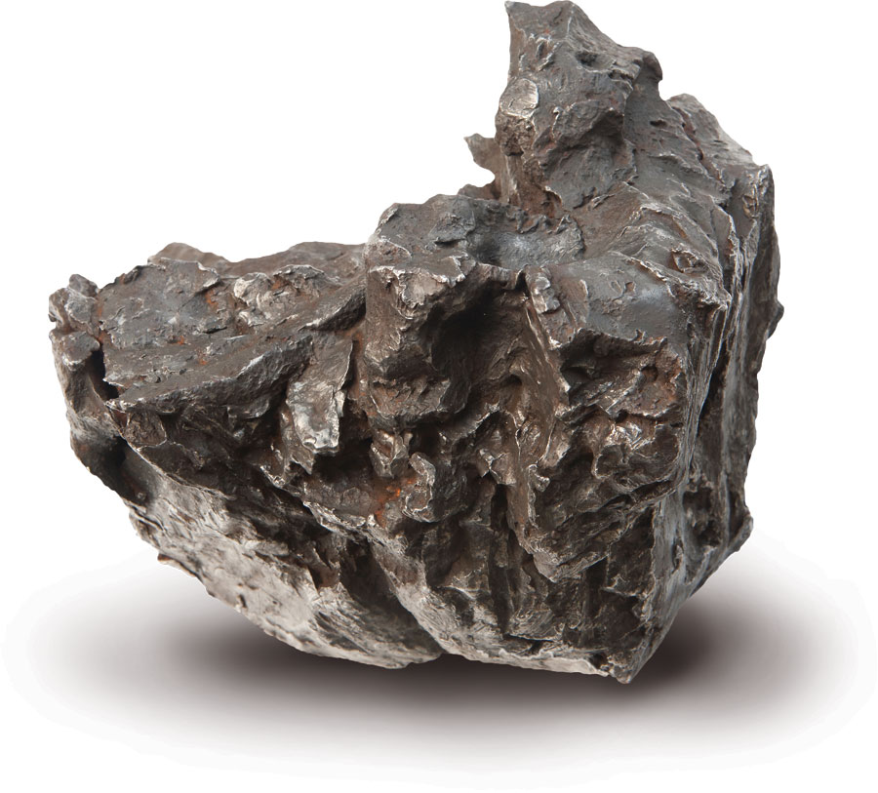
Unlocking the secrets of our universe
Study
Research looking at small particles found within meteorites called chondrules, and even smaller nanodiamonds to help understand our solar system.
Results
The studies are helping provide insights into questions about galactic chemical evolution, interstellar origins and timescales associated with the delivery of these objects to Earth.
Collaborators Max Planck Institute for Chemistry, Germany, and the University of Vienna and ETH Zurich
Notes:
Unlocking the secrets of our universe
Nuclear techniques are helping to unlock secrets of our universe locked up inside meteorites. Two ANSTO studies in conjunction with the Max Planck Institute for Chemistry in Germany, and the University of Vienna and ETH Zurich are looking at small particles found within meteorites called chondrules, which are about 1mm in diameter, and even smaller nanodiamonds which, at around 2-3 nanometres in diameter and not
visible to the naked eye, to help us better understand our solar system.
The chondrules and nanodiamonds are some of the oldest objects found in our solar system, having survived unchanged for billions of years.
Chondrules were born in the earliest phase of our solar system, before the planets were formed. Nanodiamonds, embedded in the matrix of a meteorite, are even older than our solar system itself.
ANSTO’s study into the different components of meteorites will provide insights into burning questions about galactic chemical evolution, interstellar origins and timescales associated with the delivery of these objects to our home planet.

