Slide 1
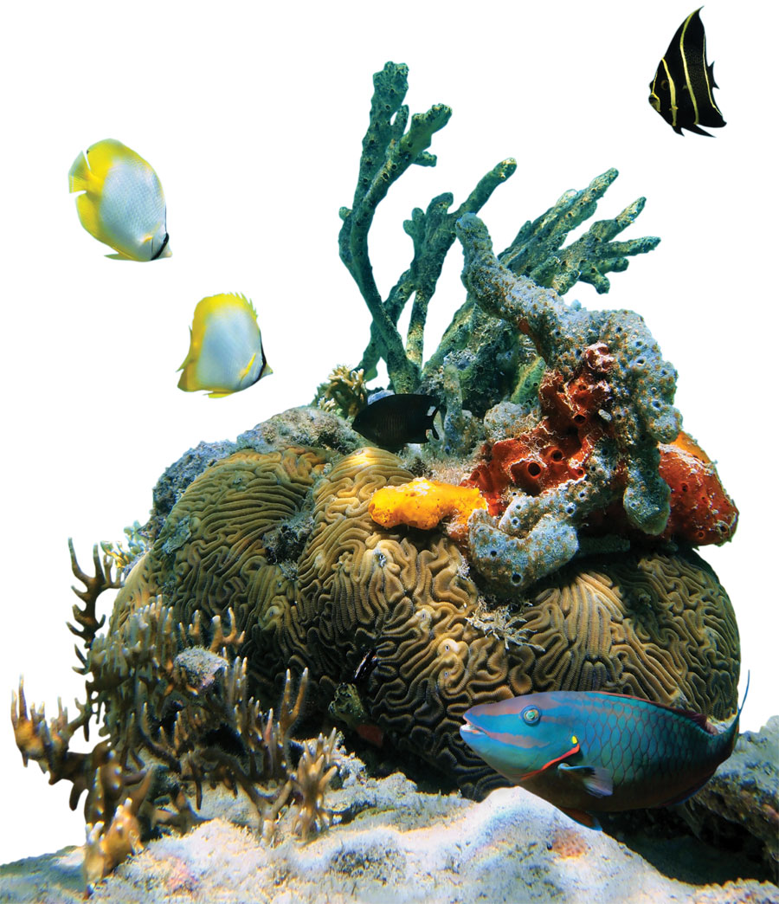
Some corals like it hot
Problem
When water temperatures get too hot, coral bleaching occurs which can lead to the death of corals.
Approach
ANSTO and international researchers discovered that coral which has survived heat stress in the past, is more likely to continue to adapt to future increases in water temperature.
Benefit
The findings will help scientists identify habitats and areas where reefs may persist in the face of climate change.
Notes:
Some corals like it hot
When water temperatures get too hot, tiny algae that provide coral with its colour and major source of food, are expelled. This phenomenon, called coral bleaching, can lead to the death of corals. While working in the Pacific Ocean, ANSTO and international researchers discovered that coral which has survived heat stress in the past and recovered to thrive in warmer water, is more likely to continue to adapt to future increases in water temperature.
These findings will help scientists identify habitats and areas where reefs may persist in the face of climate change. This will be welcomed by many of the millions of people worldwide who rely on coral reefs for sustenance and their livelihoods, particularly those who work in the fishing and tourism industries.

