Slide 1
The Environment
How can we inform sustainable environmental management strategies and add to our capacity to respond to modern environmental challenges?
1
2
3
Environmental change
Scale and speed of environmental change
Water
Sustainability and quality of key water resources and aquatic ecosystems
Contamination impacts
Pathways and impacts of contaminants in biota and the environment
Notes:
Environmental Change: How can isotopic and nuclear methods help to better understand the scale and speed of human impacts on the natural environment and climate change?
Major projects:
History of the Asian and NE Monsoon system over the past 10,000 years.
Southern Ocean and Antarctic climate systems.
Human Activity and Climate Variability
Water Resources Sustainability: How can isotopic and nuclear methods contribute to the sustainable management of the available water resources in Australia?
Major projects:
Groundwater sustainability
Nitrogen cycle in Cotton growing
Sustainable fisheries and seafood quality
Rainfall variability in the Australasian region
Contaminant Impacts: How can isotopic and nuclear methods help understand the pathways and impacts of contaminants in biota and the environment?
Major projects:
Origin and fate of atmospheric pollution (world-wide networking)
Legacy waste sites – pathways of pollutants
Nuclear accident, legacy sites of nuclear weapons testing – Fukushima research and Montobello and Marlinga test sites. Effects on biota.

Slide 2
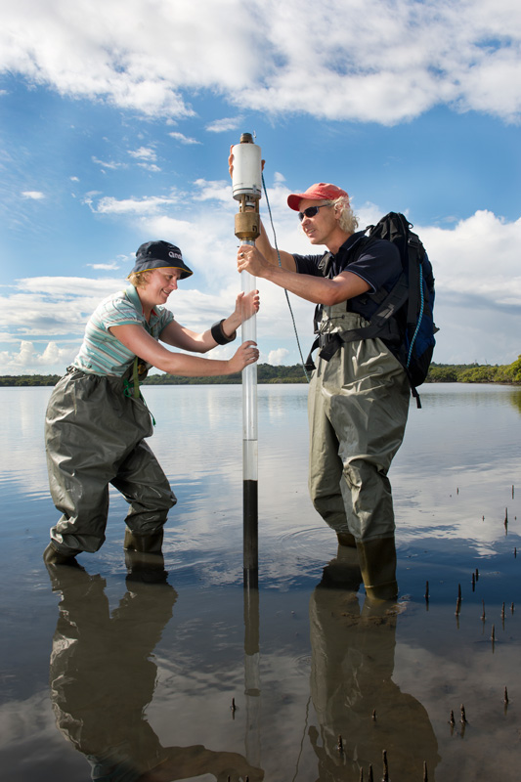
1 | Environmental Change
How can isotopic and nuclear methods help to better understand the scale and speed of human impacts on the natural environment and climate change?
Climate change
Landscape
Human activities
Notes:
Climate Change: utilising naturally occurring radionuclides and isotopes for dating and tracing past climate change with the goal of interpreting the indicators and drivers of the Earth’s climate systems
Landscape: using radionuclides and isotopes as tracers and chronometers to measure fundamental processes of natural long term landscape evolution and the impact of anthropogenic short term landscape change
Human Activities: identifying past human interactions with the environment and disentangling signals which may result from human impact or response to changing environments

Slide 3
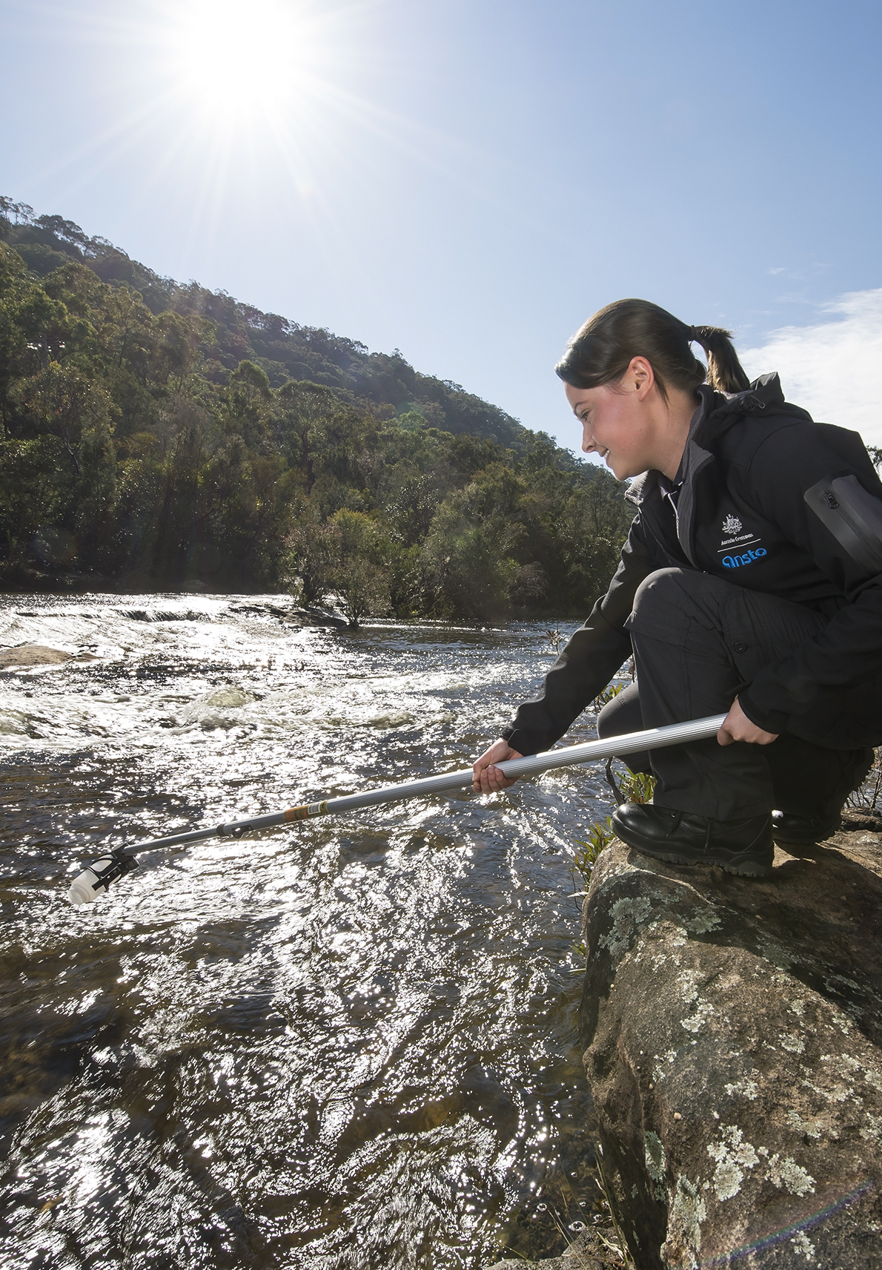
2 | Water resource sustainability
How can isotopic and nuclear methods contribute to the sustainable management of the available water resources in Australia?
Groundwater
Aquatic ecosystems
Natural variability in hydrological systems
Notes:
Groundwater: providing critical knowledge on residence times and sustainable yields of groundwater resources in regionally and nationally important catchments
Aquatic ecosystems: providing advice on impacts of land-use, contamination, water management and climatic variability on the structure, function and health of aquatic ecosystems
Natural variability in hydrological systems: improving knowledge of natural variability in rainfall and recharge by monitoring hydrological processes in key water resources regions in Australia

Slide 4
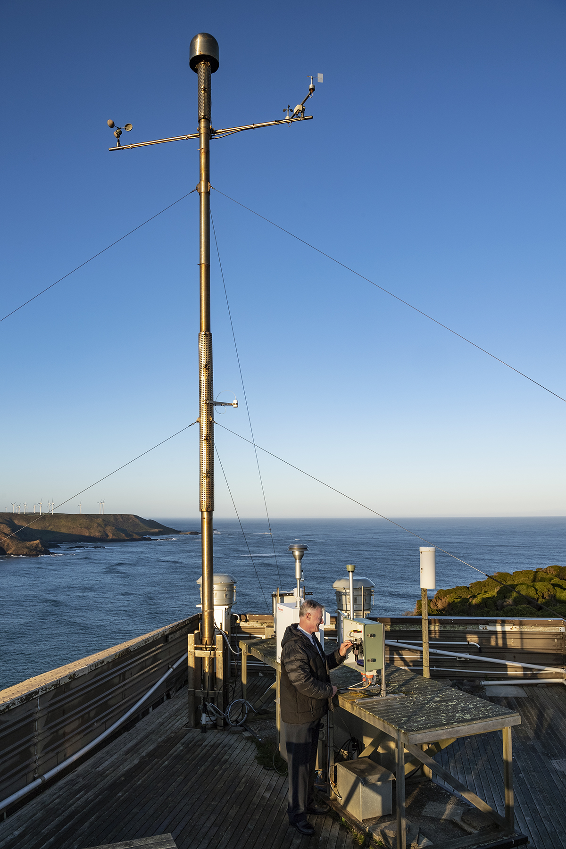
3 | Contaminant impacts
How can isotopic and nuclear methods help understand the pathways and impacts of contaminants in biota and the environment?
Atmosphere
Lithosphere
Biosphere
Notes:
Atmosphere: using atmospheric radioactivity measurements, fine particle sampling and elemental composition analysis to better understand harmful air pollution on a range of scales
Lithosphere: understanding how unique, site-specific factors of a contaminated site or nuclear facility influence its impacts on the surrounding environment
Biosphere: determining dose potentials from long-lived radionuclides at mining, legacy sites, and nuclear facilities, with emphasis on concentrated hot-particle forms, toxic co-contaminants and environmentally-relevant impacts to human- and non-human receptors

