Slide 1
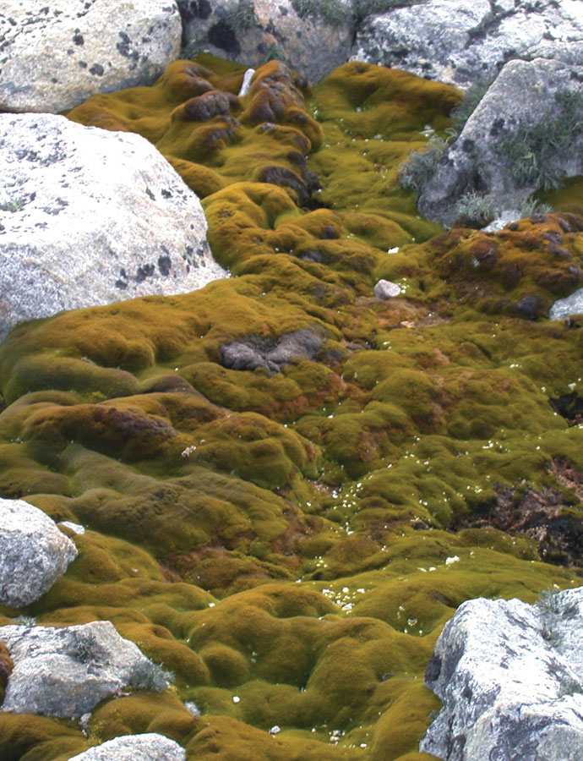
Moss reveals effects of climate change
Problem
A need to understand how vegetation will respond to future climate change.
Approach
Scientists used radiocarbon dating and measured the depth of Antarctic moss colonies.
Results
Moss growth has declined since the 1980s most likely due to moss beds drying out due to increased wind speeds linked to the Antarctic ozone hole.
Radiocarbon in the shoots of Antarctic moss are revealing the effects of Antarctic climate change
Collaborator Wollongong University
Notes:
Moss reveals biological effects of climate change
One of the few remaining untouched species on the planet is the moss of Antarctica. Research into this humble moss could provide a better understanding of how vegetation responds to future climate change.
Studies by ANSTO and the University of Wollongong on Antarctic moss shoots suggest the plant species has shown symptoms of being affected by changes in climate.
Through radiocarbon dating and measuring the depth of moss colonies, considered to be the ‘old growth forests’ of Antarctica in miniature, the scientists observed that the moss growth at some sites has declined since the 1980s.
They suggest that this is likely due to moss beds drying out, which appears to be caused by increased wind speeds linked to the Antarctic ozone hole. The results also show that climate change has made the driest continent on Earth an even harsher environment for plant life.

