Slide 1
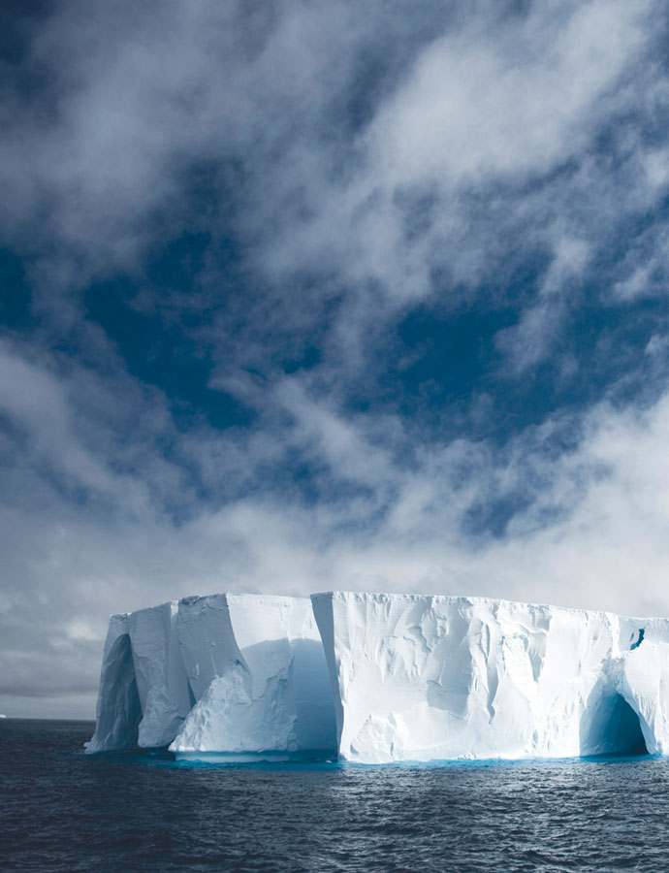
Antarctic ice in a warming world
Problem
The East Antarctic Ice Sheet holds enough water to raise the global sea level by around 60 metres and inundate coastal towns and cities.
Approach
Accelerator mass spectrometry was used to examine rocks expelled by glaciers to measure to measure changes to the ice sheet over the millennia.
Benefit
Knowing how climate responded during past changes helps scientists understand what may happen in the future.
Collaborators Macquarie University, University of Otago, Victoria University and University of Glasgow
Notes:
What will happen to Antarctic ice in a warming world?
The East Antarctic Ice Sheet holds enough water to raise the global sea level by around 60 metres and inundate coastal towns and cities around the world. Therefore knowing how climate responded during past changes will help scientists understand what may happen if climates change again.
A team of researchers from Macquarie University, University of Otago, Victoria University and University of Glasgow used ANSTO’s accelerator mass spectrometry facilities and techniques developed at ANSTO to examine the rocks that had been expelled by the glaciers. These rocks are essentially the glacier’s ‘little black box’ that can reveal when and under what conditions they were expelled from the glacier to measure how long the rocks had been exposed to cosmic rays. Rocks that have been released from the ice over time provide secrets of times past - essentially helping measure changes to the ice sheet over the millennia.

